Slide 1
Kaggle: Housing Prices Project
Kevin Armenta
8/22/19

Slide 2
Intro
The whole point of this powerpoint is to document my progress with all that I’ve done so far, and to help me keep track of data pipelines, graphs, etc.
I will also try to document anomalies that I see and investigate.

Slide 3
How We Handle Missing Values in the Combined Dataset (Test + Train), and Other Anomalies for Data Pipeline 1
Here is a basic overview of every column that had missing values and how I addressed it along with a brief description of why that value was used.
Essentially, there were missing values in the training set and testing set.
For the training set, the columns with missing values were:
LotFrontage, Alley, MasVnrType, MasVnrArea, BsmtQual, BsmtCond, BsmtExposure, BsmtFinType1, BsmtFinType2, FireplaceQu, GarageType, GarageYrBlt, GarageFinish, GarageQual, GarageCond, PoolQC, Fence, MiscFeature.
I was able to remove 3 rows from the training set (indices: 332, 948, and 1379) for the following reasons:
332: BsmtFinType2 was NaN but the rest of the Bsmt variables had values, so this value is not adequately replaced with a No Basement value because there is a basement for this house. So I just removed the entire row.
948: BsmtExposure was Nan while the other basement variables were okay, so I removed it for the same reason as above.
1379: The only row with missing Electrical info, so I removed the row.
For the testing set, the columns with missing values were the ones above and some additional columns:
MSZoning, Utilities, Exterior1st, Exterior2nd, BsmtFinTypeSF1, BsmtFinSF2, BsmtUnfSF, TotalBsmtSF, BsmtFullBath, BsmtHalfBath, KitchenQual, Functional, GarageCars, GarageArea, SaleType.
These additional missing values in the testing set were very few and far between, with only about 1 of 2 values missing from that specific column. Unfortunately, I was not able to remove these values because Kaggle requires 1459 rows to be submitted into the competition. So I had to stop doing quality control for the testing data.
There is not much nuance that went into the additional columns with missing values, I essentially just replaced all NaN’s with an NA (Not Available) value. This should definitely affect the algorithm because when these values are being encoded as one hot vectors or binary vectors, then there will be a new column created that will be extremely sparse and filled with 0’s and the algorithm will have a difficult time trying to interpret what that very sparse column will be. (This is my guess however).
I had to combine the two datasets before I replaced all the NaN’s, and before I encoeded the ordinal and nominal variables. THIS WAS DONE TO ENSURE THAT WHEN I SPLIT THE DATASET UP AGAIN, THAT BOTH THE TESTING AND TRAINING SETS HAD THE SAME NUMBER OF COLUMNS SO THAT I COULD RUN MODELS ON THEM!!!
Before going into any pipeline the data was thoroughly examined. A couple of rows were removed from the training dataset, but not the testing dataset. The sets were combined, where all the missing values in all columns are addressed.

Slide 4
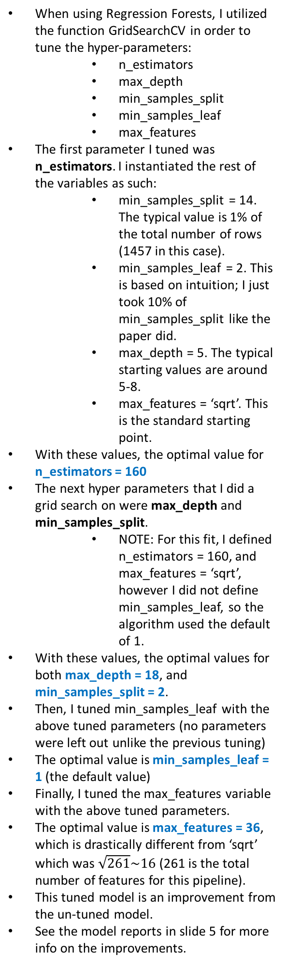
Pipeline 1
Combined and Cleaned Data
Converted Ordinal variables into the regular ordinal scale (0,1,2,3,…).
0 usually represents either the lack of a feature, or the lowest ranking of a feature. Many of these were previously missing values.
Converted all Categorical variables into One-hot vectors.
Broke up the combined dataframe into the training and testing sets.
Removed the ID column from both dataframes.
* See previous slide
DIFFERENT MODELS USED
AdaBoost
BOOSTING ALGORITHMS
LINEAR REGRESSION
REGRESSION FORESTS
The AdaBoost ensemble model takes in another model as its basis to create an ensemble of weak models, and weights each accordingly to create a stronger model . Therefore, I used my best tuned Regression Forest model as the input to build upon.
This is the first model I used Grid Search to tune the hyper parameters (See Figure to the side).
The two hyper parameters to tune in this model were learning_rate and n_estimators. They are defined in my notes.
I took about 2 separate iterations to tune the parameters. I did a wide search the first time and did a much finer search the second time once the appropriate values were found.
I also tried to tune the loss variable, which determines the type of loss equation to use. However, since the previous parameters were tuned by the default ‘linear’, the other two options ‘square’ and exponential had no chance
We normalized the training set and testing set.
Used basic linear regression to create the model.
The RMSLE (Root Mean Square Logarithmic Error) of the predictions is 1.77543.
When using Regression Forests, I utilized the function GridSearchCV in order to tune the hyper-parameters:
n_estimators
max_depth
min_samples_split
min_samples_leaf
max_features
The first parameter I tuned was n_estimators. I instantiated the rest of the variables as such:
min_samples_split = 14. The typical value is 1% of the total number of rows (1457 in this case).
min_samples_leaf = 2. This is based on intuition; I just took 10% of min_samples_split like the paper did.
max_depth = 5. The typical starting values are around 5-8.
max_features = ‘sqrt’. This is the standard starting point.
With these values, the optimal value for n_estimators = 160
The next hyper parameters that I did a grid search on were max_depth and min_samples_split.
NOTE: For this fit, I defined n_estimators = 160, and max_features = ‘sqrt’, however I did not define min_samples_leaf, so the algorithm used the default of 1.
With these values, the optimal values for both max_depth = 18, and min_samples_split = 2.
Then, I tuned min_samples_leaf with the above tuned parameters (no parameters were left out unlike the previous tuning)
The optimal value is min_samples_leaf = 1 (the default value)
Finally, I tuned the max_features variable with the above tuned parameters.
The optimal value is max_features = 36, which is drastically different from ‘sqrt’ which was $\sqrt{261}\sim 16$ (261 is the total number of features for this pipeline).
This tuned model is an improvement from the un-tuned model.
See the model reports in slide 5 for more info on the improvements.
*Insert a graph here from Python that can plot the different values of the parameters for GridSearchCV and color code the value of the metric used to determine how good the model was. Practice Data Visualization.
LINEAR RIDGE REGRESSION
We normalized the training set and testing set.
Used ridge linear regression to create the model. This adds a regularization factor to the regular linear regression equation to prevent the model from changing the weight factors too much.
The RMSLE (Root Mean Square Logarithmic Error) is listed next to alpha values.
Alpha = 0.001 -> 0.1939
Alpha = 0.01 -> 0.18951
Alpha = 0.1 -> 0.17254
Alpha = 0.25 -> 0.1624
Alpha = 0.5 -> 0.15573
Alpha = 0.75 -> 0.15332
Alpha = 1 -> 0.15273
Alpha = 2 -> 0.15741
Alpha = 5 -> 0.18649
Alpha = 10 -> 0.23027
Gradient Boosting
c
c
The GradientBoosting creates its own model from scratch, which is a tree-based algorithm like random forest.
I used RandomizedSearch for the learning_rate and n_estimators parameters, but a regular GridSearch for the rest of the parameters.
There are different categories of hyper-parameters to tune. They are: tree, boosting, and miscellaneous parameters. We only need to focus on the first 2 types as the last one doesn’t have important parameters.
I random searched the learning rate by generating random values between 10^-4 - 10^0. I did it in a clever way such that the values generated were just as likely to grab numbers between 0.0001 – 0.001 as 0.1 – 1. I just picked a range of values at regular intervals for n_estimators. RandomizedSearchCV randomly pairs these values together. On second thought, I maybe should have used a regular GridSearch instead of a random search for these parameters. I will try this next time.
I did a regular grid search for the following parameters:
n_estimators and max_depth together.
min_samples_split and min_samples_leaf
max_features and subsample.
This resulted in 7 total tuning sessions . I could’ve improved on my last model if I tuned the learning_rate down further and increased the n_estimators value.
This model vastly outperformed the AdaBoost + Regression Forest model from above.
*Insert graphs here from Python that can show the improvements of the model over different parameter tunings. Think of a metric to use to show how good the model is. Maybe show some GridSearch graphs like above? Be creative, think of ways to communicate the data
c
c
c
c
Note: Here are a couple of other linear regression algorithms that I will look at some other time for other projects. I assume the other models will perform better.
RidgeCrossValidation (!)
Lasso and LassoCrossValidation (!)
Least Angle Regression
LARS Lasso
Multi-task Lasso
Elastic-Net
Multi-task Elastic-Net
Robustness Regression (w/errors)
Huber Regression
Polynomial Regression (!)
Bayesian Regression (!)
Logistic Regression
Stochasitc Gradient Descent

Slide 5
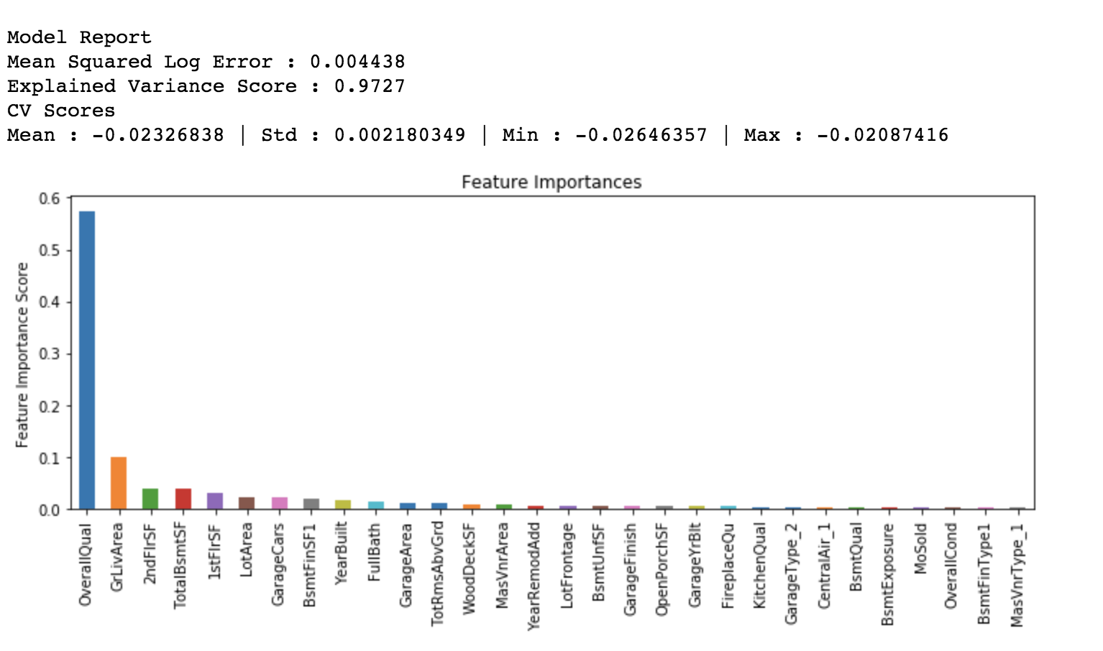
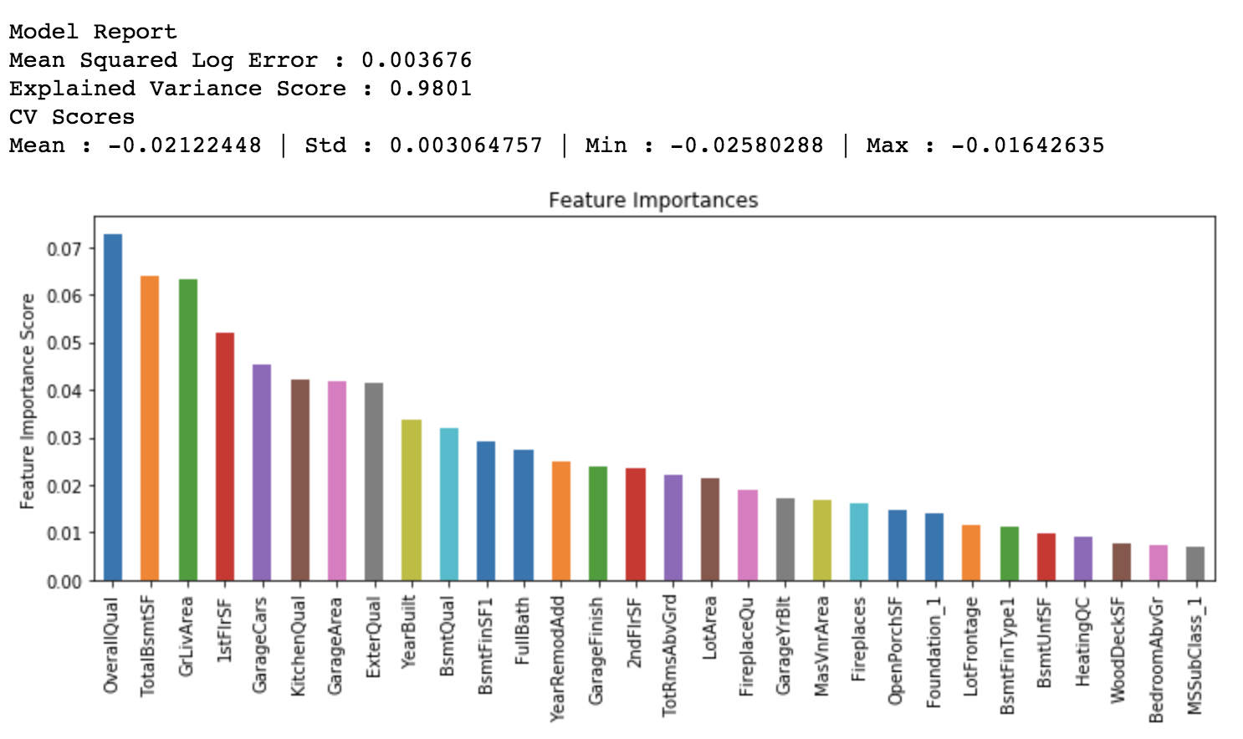
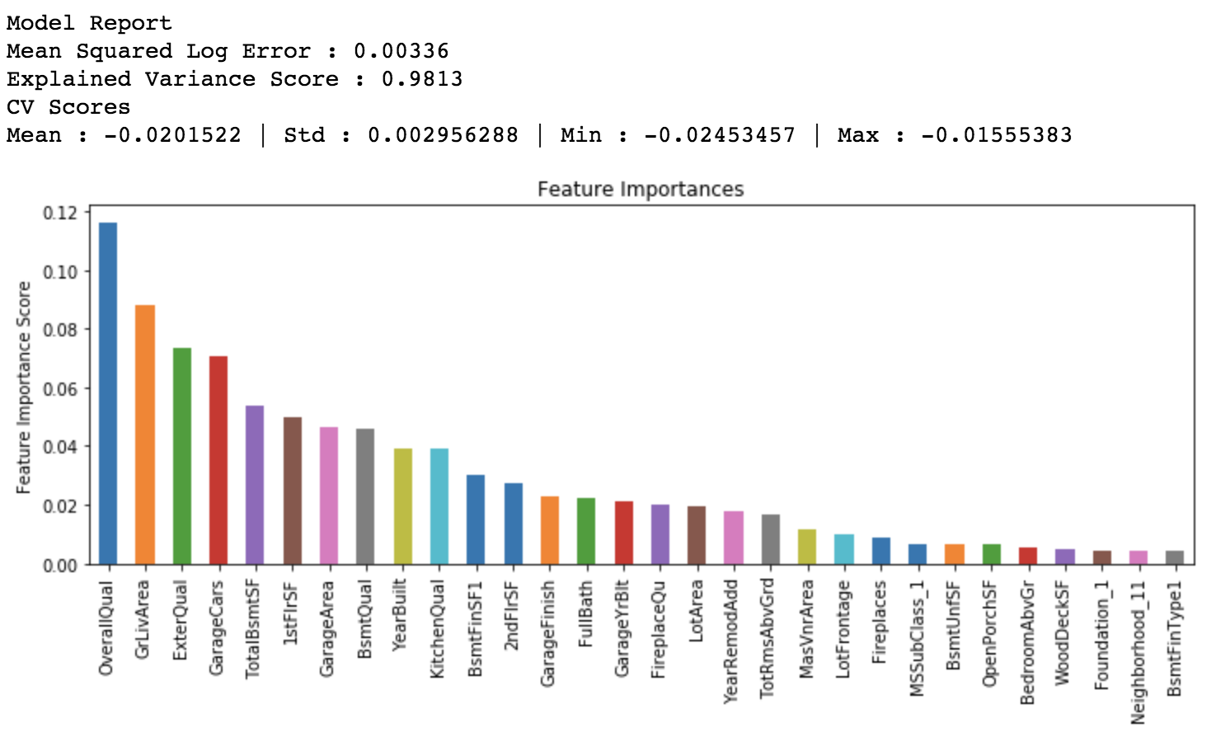
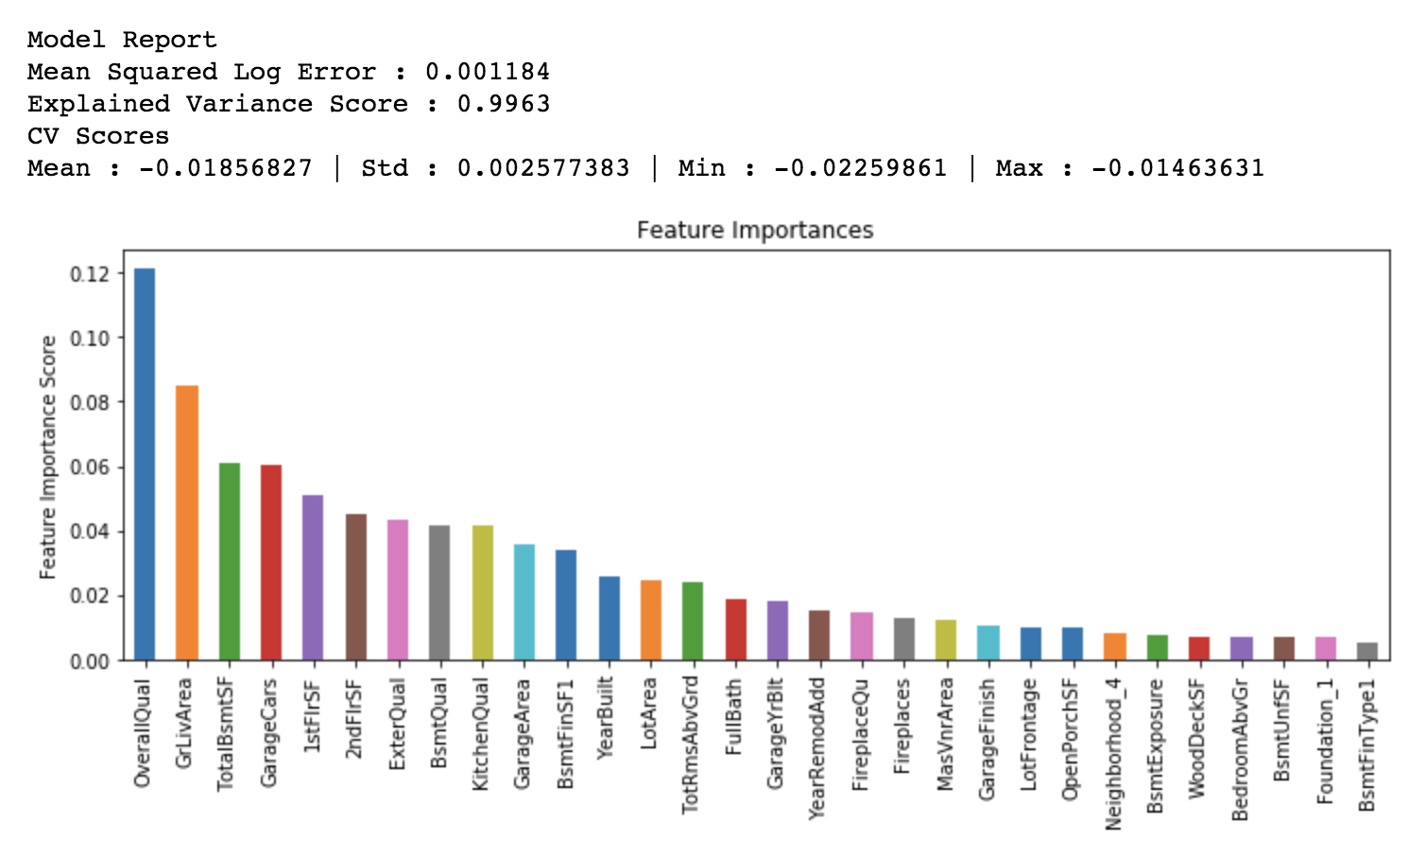
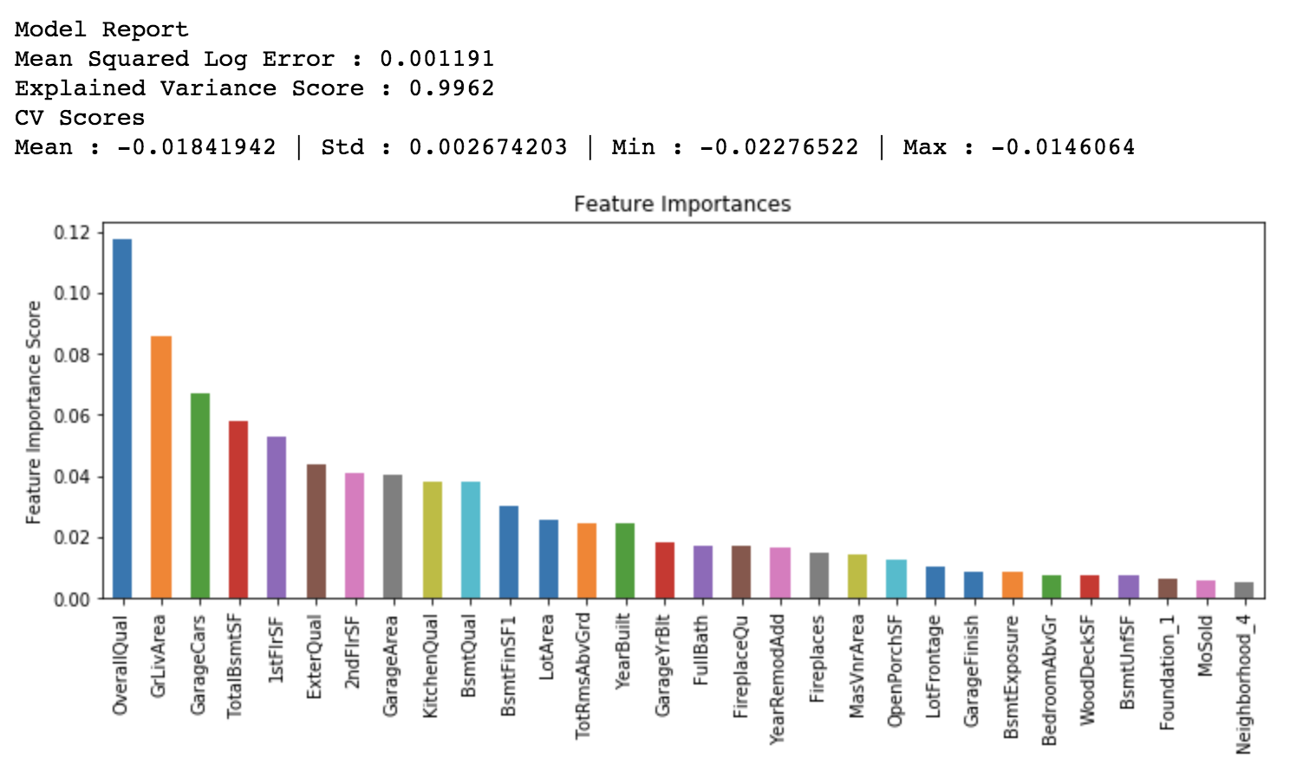

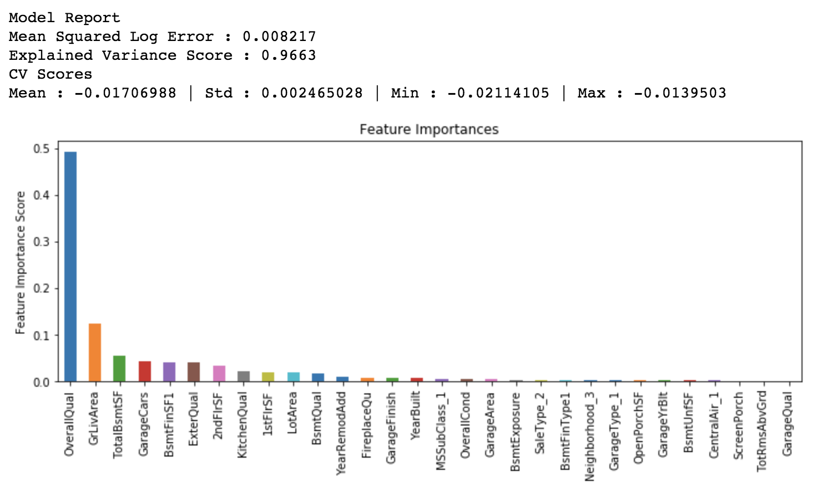
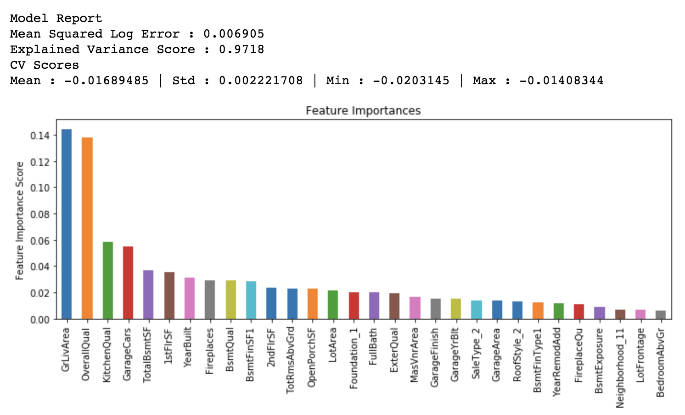
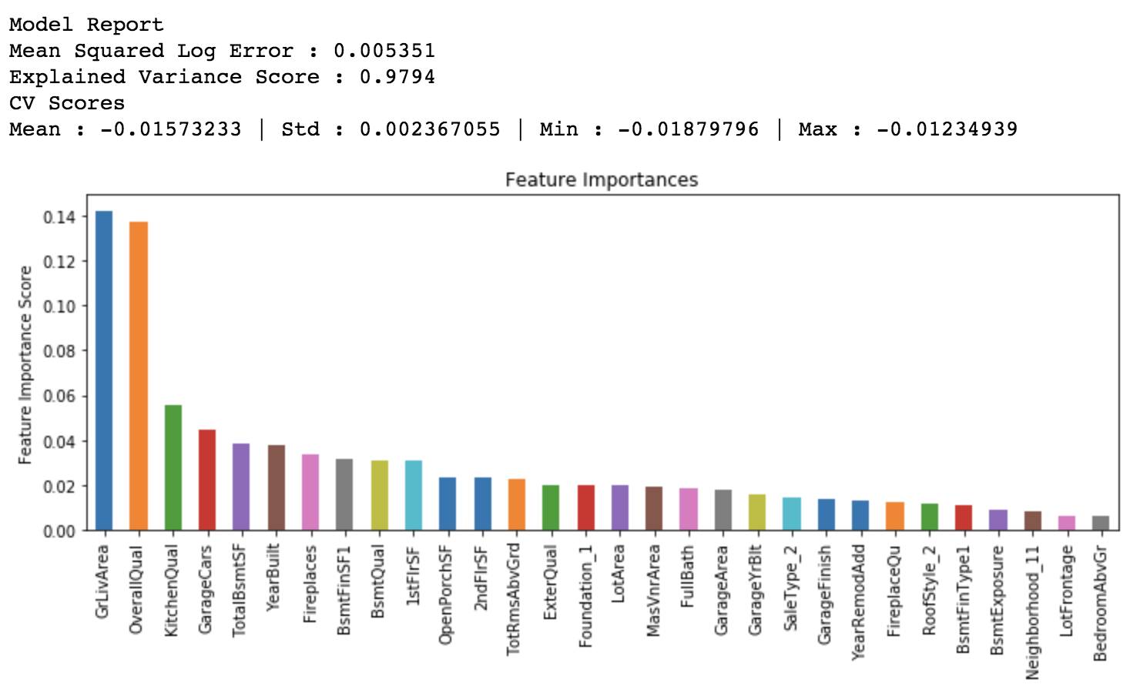
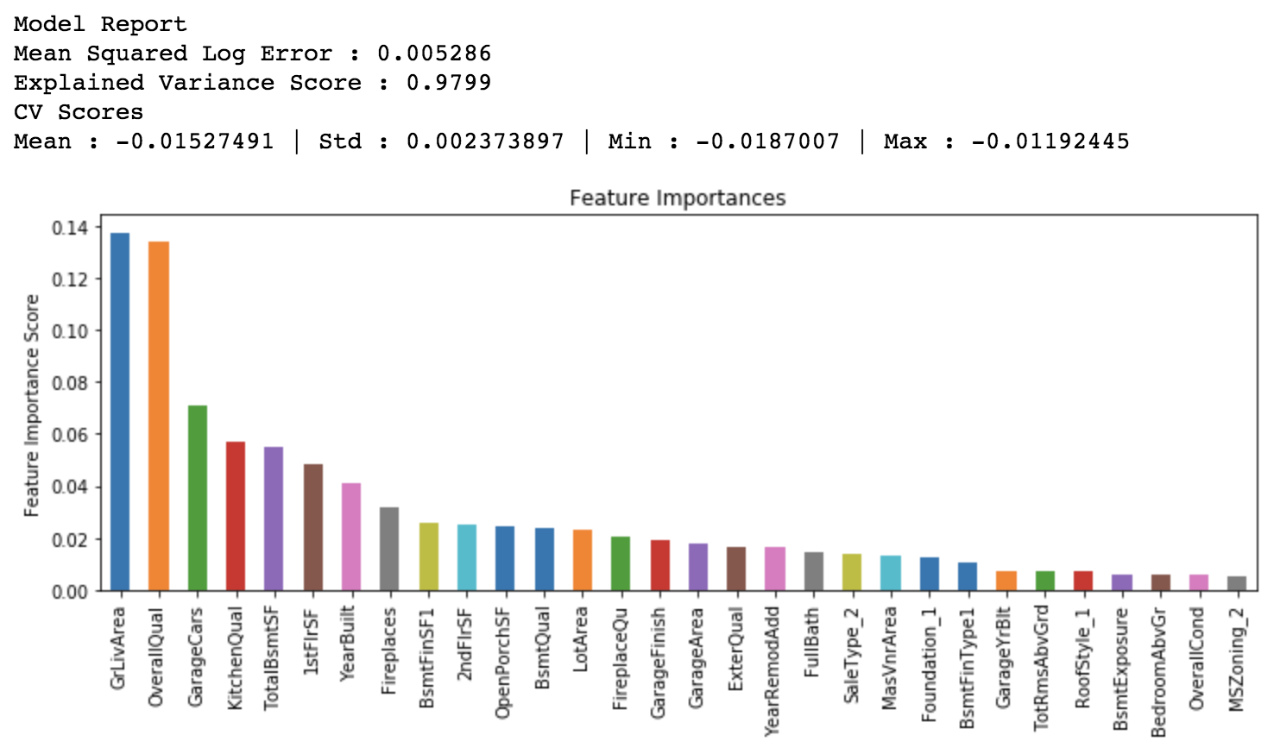
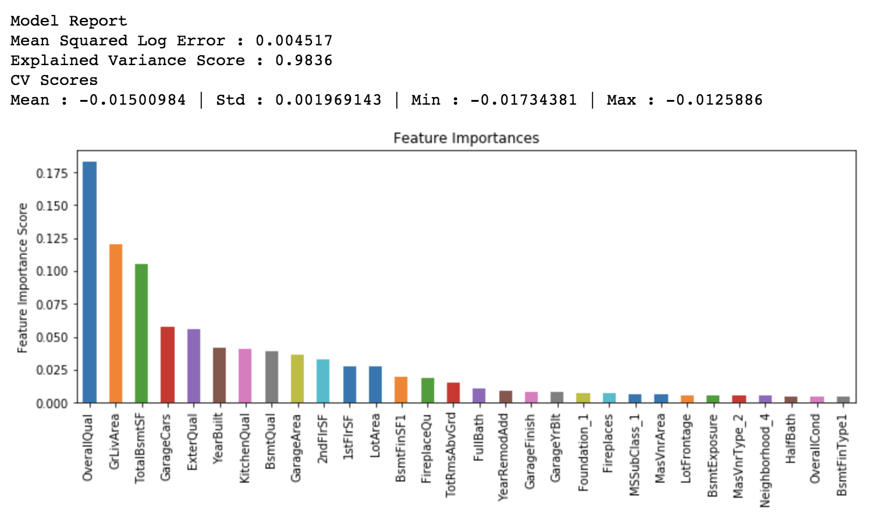
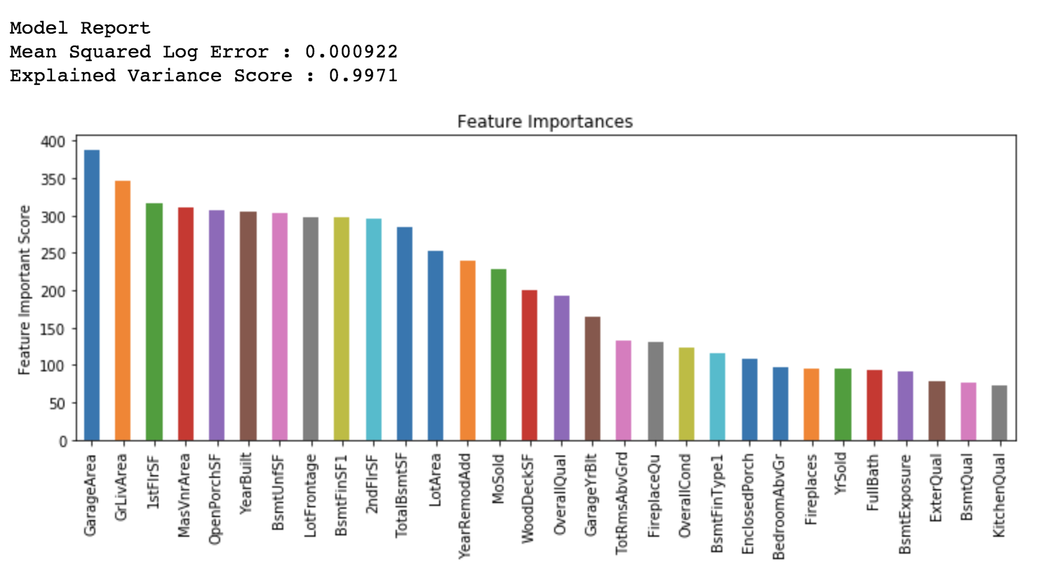
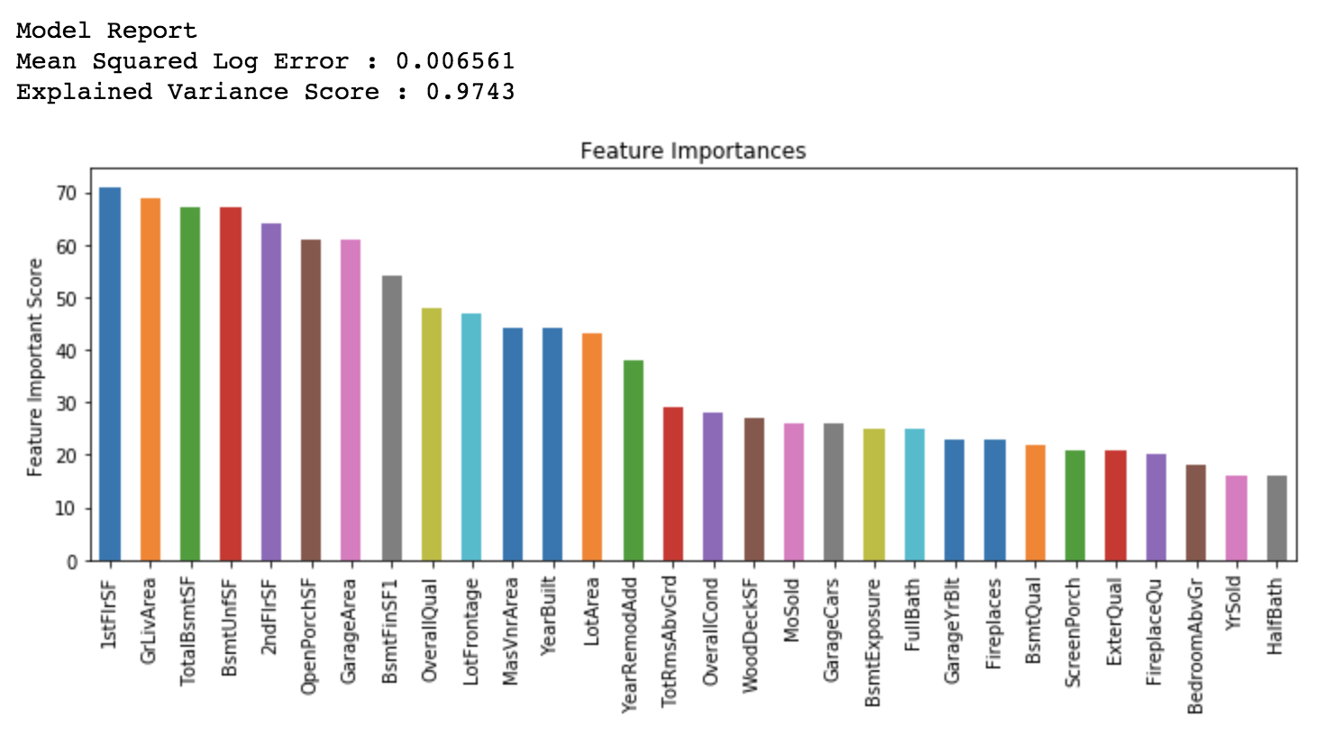
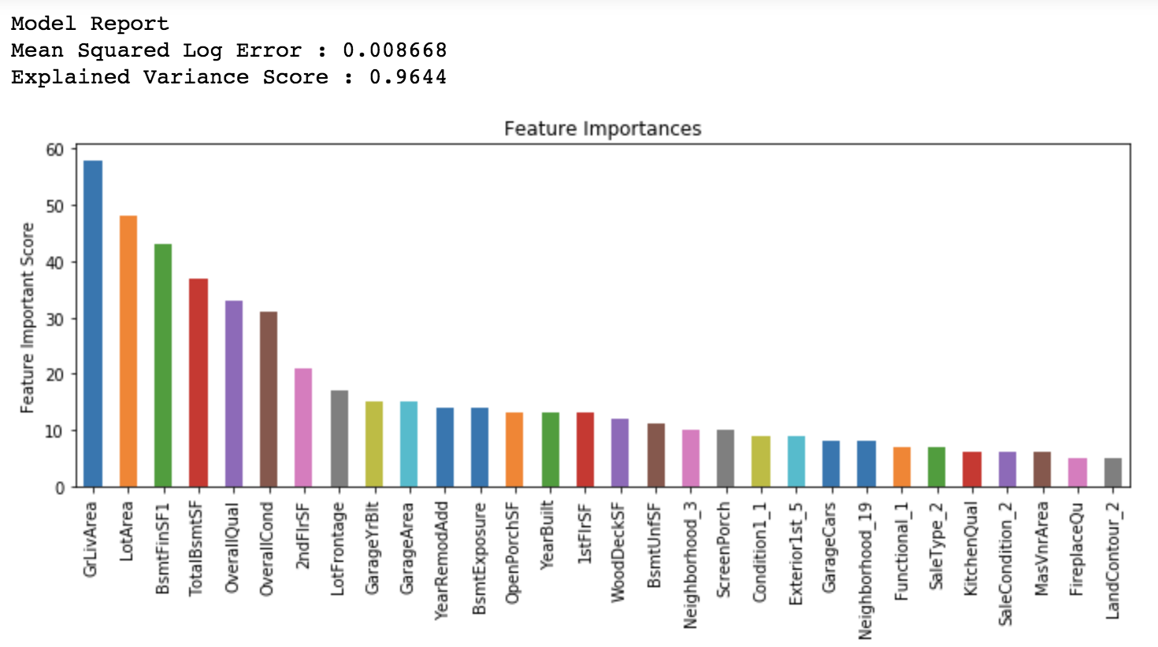
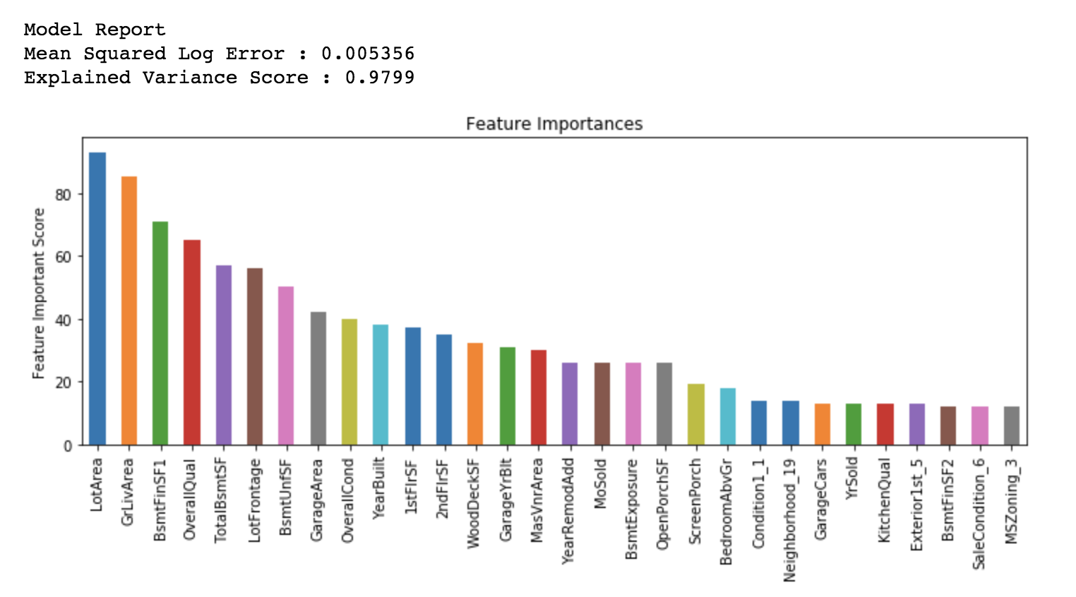
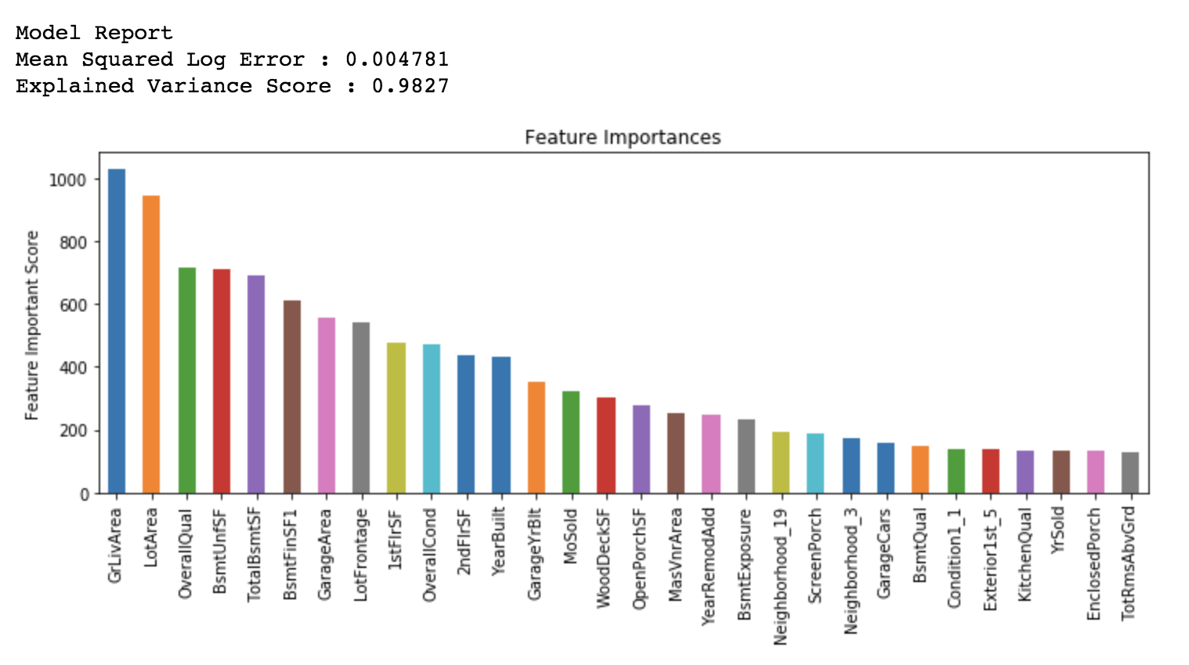
Pipeline 1
Model Reports For Random Forest Regressors and Various Boosting Algorithms
RandomForestRegressor
1
RandomForestRegressor
2
RandomForestRegressor
3
AdaBoost + RandomForestRegressor
1
AdaBoost + RandomForestRegressor
2
1st run. No hyper-parameter tuning.
Random_state = 2, n_estimators = 10
After tuning 4 parameters (n_estimators, (max_depth, min_samples_split)*, min_samples_leaf)
Random_state = 2, n_estimators = 160, max_depth = 18, min_samples_split = 2, min_samples_leaf = 1
After tuning the previous parameters, plus max_features.
Random_state = 2, n_estimators = 160, max_depth = 18, min_samples_split = 2, min_samples_leaf = 1, max_features = 36
I decided to boost the random forest regressor model from the previous square with AdaBoost.
2 boosting parameters were tuned using a randomized search CV on learning rate (0.6857) and n_estimators (49).
This model greatly improved compared to the previous square.
Tuned 2 boosting parameters using a grid search CV on learning rate (0.75) and n_estimators (59).
Used the previous values from random search to fine tune my search.
This model improved slightly compared to the previous square.
AdaBoost + RandomForestRegressor
3
* Denotes that a grid search was done on both parameters at the same time
2
Gradient Boosting Regressor
3
4
Gradient Boosting Regressor
1
Gradient Boosting Regressor
Gradient Boosting Regressor
Tuned 2 boosting parameters using a grid search CV on learning rate (0.77) and n_estimators (67).
Used the previous values from gridsearch to fine tune my search.
This model improved slightly compared to the previous square.
Untuned Gradient Boosting algorithm. Will submit results to Kaggle to see how it performs compared to the tuned Adaboosting model.
It actually already outperformed the Adaboosting model!!
Conducted a randomized parameter search for learning_rate (0.05180373111740152) and n_estimators (140).
subsample=0.8, min_samples_split = 14, min_samples_leaf = 2, max_depth = 5, max_features = ‘sqrt’
Conducted a grid parameter search for learning_rate (0.0580) and n_estimators (200).
subsample=0.8, min_samples_split = 14, min_samples_leaf = 2, max_depth = 5, max_features = ‘sqrt’
Tuned approximately 5 parameters for the Gradient Boosting model.
min_samples_split = 19, min_samples_leaf = 2, max_depth = 4, learning_rate = 0.0580, n_estimators = 380 have been tuned.
max_features = ‘sqrt’, subsample =0.8 have been assumed and will be tuned later.
Gradient Boosting Regressor
5
XGB Regressor
1
XGB Regressor
2
XGB Regressor
3
XGB Regressor
4
Tuned approximately all 7 parameters for the Gradient Boosting model.
min_samples_split = 19, min_samples_leaf = 2, max_depth = 4, learning_rate = 0.0580, n_estimators = 380, max_features = 30, subsample =0.7 have been tuned.
This is the final model for Gradient Boosting.
Preliminary XGBoost model (no tuning done) to find n_estimators for the learning_rate.
Instantiated values: learning_rate = 0.1, max_depth = 6, min_child_weight = 2, gamma = 0, subsample = 0.6, colsample_bytree = 0.1, scale_pos_weight = 1, seed = 13, objective = ‘reg:squarederror’, n_estimators = 300
XGBoost tuned for n_estimators, min_child_weight, and max_depth.
Instantiated values: learning_rate = 0.1, max_depth = 3, min_child_weight = 2, gamma = 0, subsample = 0.6, colsample_bytree = 0.1, scale_pos_weight = 1, seed = 13, objective = ‘reg:squarederror’, n_estimators = 300
XGBoost tuned for many parameters and recalibrated to find better value for n_estimators.
Instantiated values: learning_rate = 0.1, max_depth = 3, min_child_weight = 2, gamma = 0, subsample = 0.9, colsample_bytree = 0.8, scale_pos_weight = 1, seed = 13, objective = ‘reg:squarederror’, n_estimators = 100
Performed worse than previous model on Kaggle!
XGBoost tuned for most parameters and recalibrated to find better value for n_estimators.
Instantiated values: learning_rate = 0.1, max_depth = 3, min_child_weight = 2, gamma = 0, subsample = 0.9, colsample_bytree = 0.8, scale_pos_weight = 1, seed = 13, objective = ‘reg:squarederror’, n_estimators = 213, reg_alpha = 0.001, reg_lambda = 1
XGB Regressor
5
XGBoost model completely tuned
learning_rate = 0.01, max_depth = 3, min_child_weight = 2, gamma = 0, subsample = 0.9, colsample_bytree = 0.8, scale_pos_weight = 1, seed = 13, objective = ‘reg:squarederror’, n_estimators = 2438, reg_alpha = 0.001, reg_lambda=1
THESE FEATURES WERE COMPARED IN THE EXCEL FILE ‘KeepingTrackOfModels_DataPipeline1’

Slide 6

DATA PIPELINE 2
Main differences between this pipeline and pipeline 1:
Missing values are taken much more seriously, and inferential stats is utilized in order to fill in the gaps for nominal variables.
Also, linear regression is used for certain missing values for numeric variables.
Feature engineering is utilized to combine features or create completely new features.
Using descriptive statistics, certain extremely uniform features (features that have too much of a single value) are removed, and features that have too many categories are removed. Many features are removed from this pipeline.
In pipeline 3, we will be less strict about which features to remove if we do not get the results we are hoping for.

Slide 7
DATA PIPELINE 2
HANDLING MISSING DATA MORE SERIOUSLY PART I
MSZoning
I used a Chi-Square Independence Test and found that MSZoning and Neighborhood are not independent.
What do I did was I took the probabilities that MSZoning will take a specific value based on the Neighborhood value. When the Neighborhood is IDOTRR, I substituted RM for the MSZoning value (P(RM|IDOTRR) = 0.755555). When the Neighborhood value is Mitchel, I substituted RL for the MSZoning value (P(RL|Mitchel) = 0.92035).
LotFrontage
I replaced NaN’s with 0, as 0 is not originally in the dataset. This is what the NaN is supposed to represent. This is the same thing I did for the first data pipeline.
Alley
I replaced NaN’s with a No Alley category. This is the same as the first pipeline.
Utilities
Do not worry about this, as this is one of the variables that I will throw out later.
Exterior1st & Exterior2nd
There is only one missing value for this category. I tried to see if I would be able to guess its value from other categories such as YearBuilt, Neighborhood, YearRemodAdd.
I ended up using YearBuilt and Neighborhood to find the probabilities of the values of Exterior1st and Exterior2nd. P(MetalSd | (YB=1940,NH=Edwards)) = 2/5, which is the highest probability compared to other Exterior1st and Exterior2nd values.
I replaced the missing values with MetlaSd.
MasVnrType & MasVnrArea
For MasVnrType, I looked at the Exterior1st and Exterior2nd variables since these both were not independent of MasVnrType (Chi squared independence test p ~= 0).
I looked at all the combos of Exterior1st and Exterior2nd, and found out what the most common MasVnrType for all 5 different combos is ‘None’. The most common value for MasVnrArea when MasVnrType = None is 0. There was one instance in which MasVnrArea > 0 for when MasVnrType = NaN. I looked through the dataset and found that when MasVnrType = None, there were a couple of instances in which MasVnrArea > 0. Because of this, I didn’t treat this entry any differently from the rest, and still replaced the MasVnrType with the value of ‘None’.
BsmtQual
For the most part, NaN = NA = No Basement for most entries.
There are two indices that are the exception (2215 & 2214). These two entries represent unfinished basements. When I looked at the features BsmtFinType1 and BsmtFinType2, I found the most common value for BsmtQual was TA when they both were classified as Unfinished.
I decided to look at Foundation instead as an indicator of the quality of the basement, as a Chi-Squared Independence test showed there was an extremely low chance that they were independent.
For index 2214 w/ Foundation = Stone, P(BQ=TA|F=Stone) = 0.7, which was the highest probability. This entry was replaced with TA
For index 2215 w/ Foundation = Pconc, P(BQ=Gd|F=Pconc) = 0.688, which was the highest probability. This entry was replaced with Gd.
BsmtCond
79 of these NaN values correspond with NA = No Basement
There are 3 exceptions: indices 2037, 2182, 2521.
I ended up using BsmtQual to determine this value. I found for all 3 indices, the chances that BsmtCond = TA was the most likely option:
P(BC=TA|BQ=TA) = 0.918 (indices 2037, 2521)
P(BC=TA|BQ=Gd) = 0.9378 (index 2182)
BsmtExposure
79 of these NaN’s correspond to NA = No Basement.
There are 2 exceptions (indices = 2345,1484)
I ended up using BsmtQual to determine this value because according to the variable definitions, this one tells us the height of the basement and it is not independent of BsmtExposure.
I replaced the 2 exceptions with No Exposure because that was the most likely value: P(BE=No|BQ=Gd) = 693/1205 = 0.575
BsmtFinType1 & BsmtFinType2
Replaced the value with NA because there was no basment for this one entry
BsmtFinSF1 & BsmtFinSF2
Replaced with 0 for the one entry. It was the same entry as above
BsmtUnfSF & TotalBsmtSF
Replaced this entry with a 0 because there is no basment.

Slide 8
DATA PIPELINE 2
HANDLING MISSING DATA MORE SERIOUSLY PART II
BsmtFullBath & BsmtHalfBath
Both entries didn’t have a basement so I subbed a 0 for both values.
KitchenQual
I used OverallCond and OverallQual in order to predict the value of KitchenQual. There is only one missing value in this category.
P(KQ = TA | (OQ=5,OC=3)) = 14/15 = 0.9333. I subbed the NaN with TA.
Functional
There were 2 NaN values for this feature. I checked OverallCond and OverallQual in order to guess this value. I couldn’t use both at the same time because then I was only left with these entries, and they can’t be used to predict their own values (duh).
I only used OverallCond to predict the Functional value because it’s p-value from Chi-squared independence test was much smaller (10^-128 <<< 10^-37). This made it easy because they both had the same OC value of 5).
P(F=Typ|OC=5) = 0.9579, therefore we replaced the NaN value with Typ. This also made sense as the paper describing the variables said to assume Typ if no other info.
FireplaceQu
Created a for loop to check if they all corresponded to no Fireplaces. They all did so I replaced all NaN’s with NA = No Fireplace.
GarageType
All NaN’s are associated with No Garage, so I replaced them all with NA.
GarageYrBlt
157 of the NaN’s correspond to NA = No Garage.
There were 2 exceptions (indices 2123, 2573). I found that YearBuilt and GarageYrBlt were highly correlated so I just substituted the YearBuilt value into the GarageYrB lt value and called it a day. Fot index 2123, GYB=1910. For index 2573, GYB=1923)
I tried to use Linear Regression at first since these were both numerical variables (and I even added YearRemodAdd because you need at least 2 dependent variables in order to use lin regression) but I ended up running into a bunch of trouble and it wasn’t worth to go through for 2 entries.
GarageFinish
Almost all NaN’s correspond to NA = No Garage except for the same indices as above (2123,2573).
I used the GarageYrBlt variable to guess this value and I found that it went against my intuition:
P(GF=Unf|GYB=1910) = 1 (100%)
P(GF=Unf|GYB=1923) = 5/6
So even though the garages were built long ago, there is an extremely high chance that they are still unfinished.
GarageCars
There is only one missing value for this entry and it is for index 2573. I used GarageType and GarageFinish to predict the number of cars that fit in the Garage.
The most likely value is 1, so thats what I substituted the NaN with.
GarageArea
There was only one missing value for this category. I grabbed these area variables to do linear regression to predict this variable:
LotArea, TotalBsmtSF, GrLivArea, GarageArea, WoodDeckSF, OpenPorchSF, EnclosedPorch, 3SsnPorch, ScreenPorch, PoolArea.
I used Ridge Regression with alpha=0.01, and the value it gave me was GarageArea ~ 446.6125
GarageQual
Most of the values (~157) of the NaNs = NA = No Garage
There were 2 exceptions: indices 2123, 2573.
I used GarageType and GarageFinish in order to predict the value of GarageQual.
P(GQ=TA | (GT=D,GF=Unf)) = 0.8511, therefore I subbed both NaN’s for TA since it was the most likely.
GarageCond
Most values of NaN are NA = No Garage, but the two indices 2123,2573 do not follow this.
GarageQual is extremely dependent on GarageCond (p=0.0), so I used this variable as an indicator.
P(GC=TA|GQ=TA) = 0.982, so I filled the spot for these two indices with TA.
PoolQC
Don’t worry about this feature because it’s going to be removed.
Fence
There is no supplemental variable that can tell us if there is no fence (NaN = NA = No Fence) or if its simply missing, so I just subbed all NaN’s for NA.
MiscFeature
2810 / 2811 of these NaN’s are NA = No MiscFeature. There is an exception with index 2546, where the MIscVal = 17,000.
After looking at all the different MiscFeatures, I see that it is most likely that the MiscFeature is a second garage (Gar2).
SaleType
I used SaleCondition to predict this variable because these two are very closely related (p=0.0).
P(ST=WD|SC=Normal) = 0.9637, so I filled the one NA value with WD.
NOTE: How I replaced the missing values is not perfect. I tried to predict categorical values using other categorical variables, but this process is never perfect, and there are probably some other variables I could have added to my analysis, but I didn’t dig too deep for each variable because I can’t afford to spend that much time for each variable.

Slide 9

DATA PIPELINE 2
FEATURE ENGINEERING
THE FOLLOWING SLIDES ALL DEAL WITH THE ENGINEERING OF DIFFERENT FEATURES THAT I DEEMED QUESTIONABLE AND NEEDED FURTHER INVESTIGATION TO SEE IF THEY SHOULD BE REMOVED FROM THE DATASET, OR MODIFIED IN ANY WAY. THIS IS NOT LIKE DEALING WITH MISSING VALUES, THERE IS MORE GRAPHICAL ANALYSIS AND MAY BE MORE INTENSIVE. THERE WILL BE MUCH FEWERE FEATURES ADDRESSED PER SLIDE COMPARED TO THE MISSING VALUES. THIS SLIDE IS HERE TO GIVE CONTEXT TO THE FOLLOWING SLIDES.

Slide 10
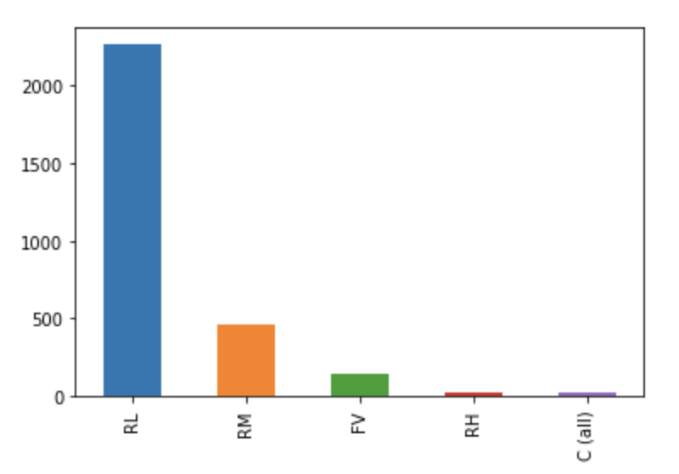
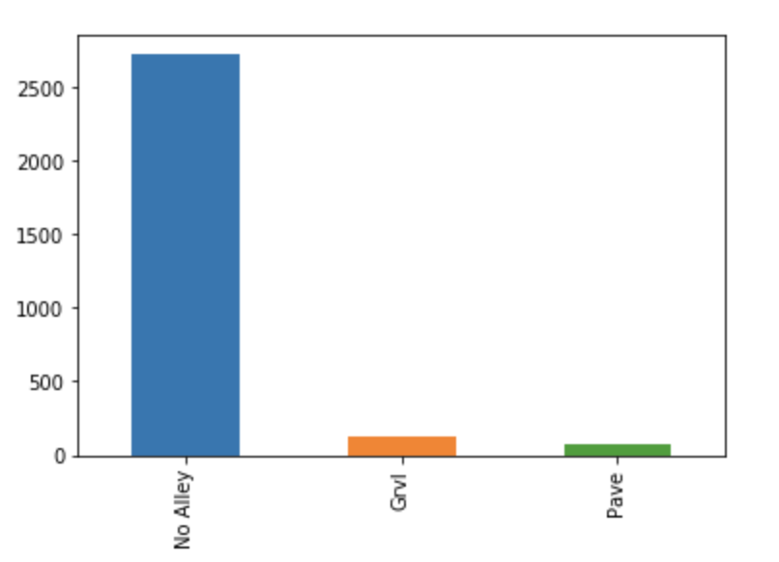
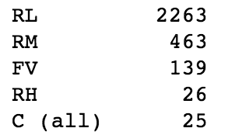
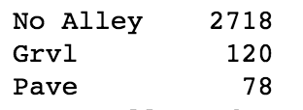
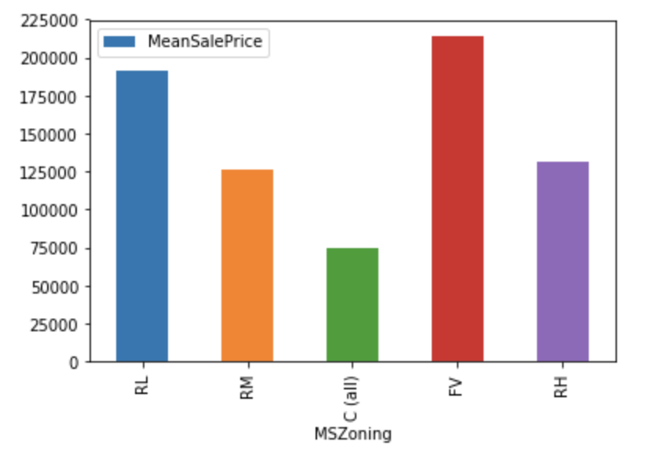
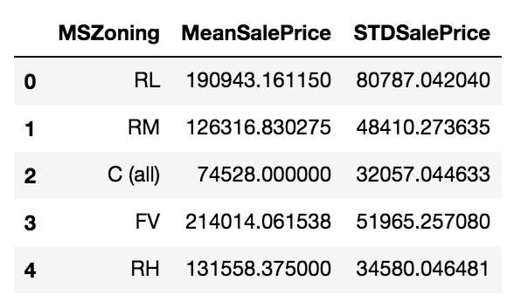
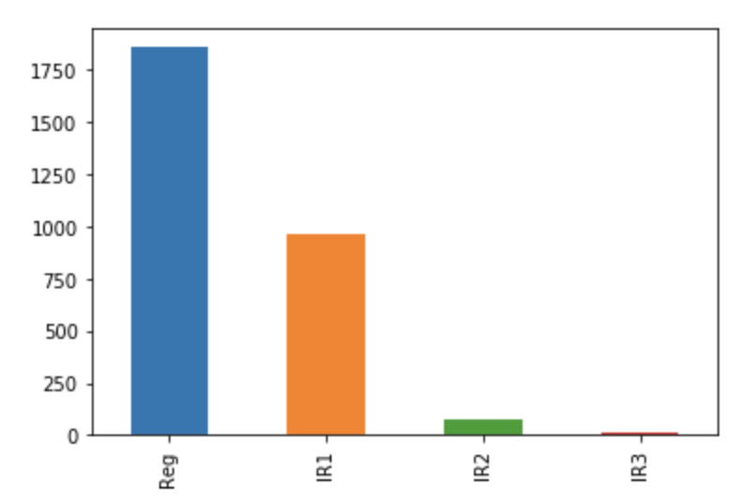
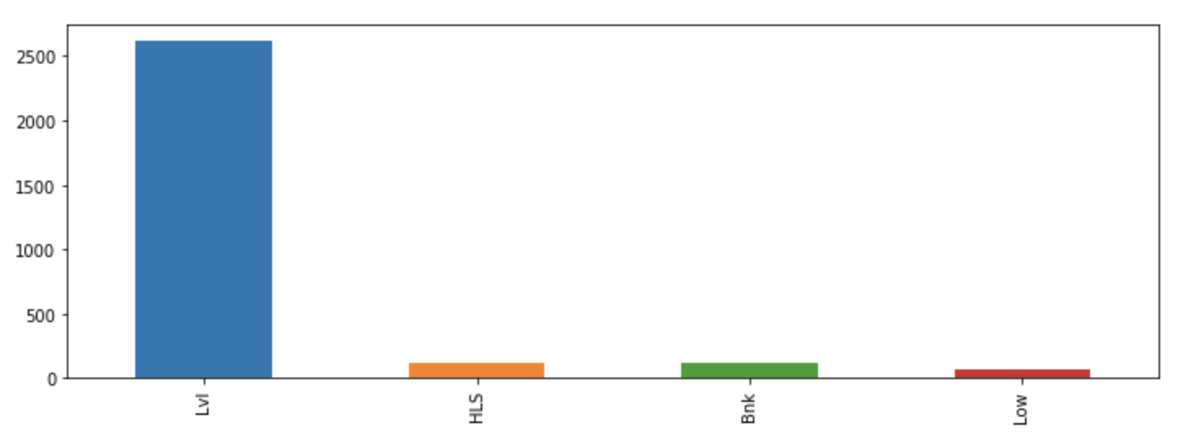
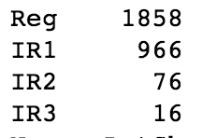
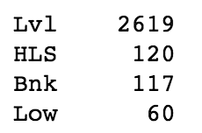
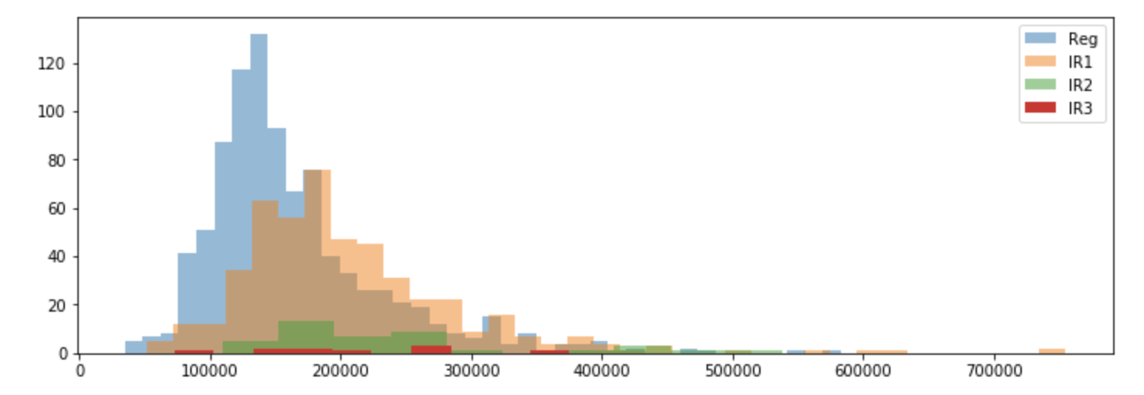
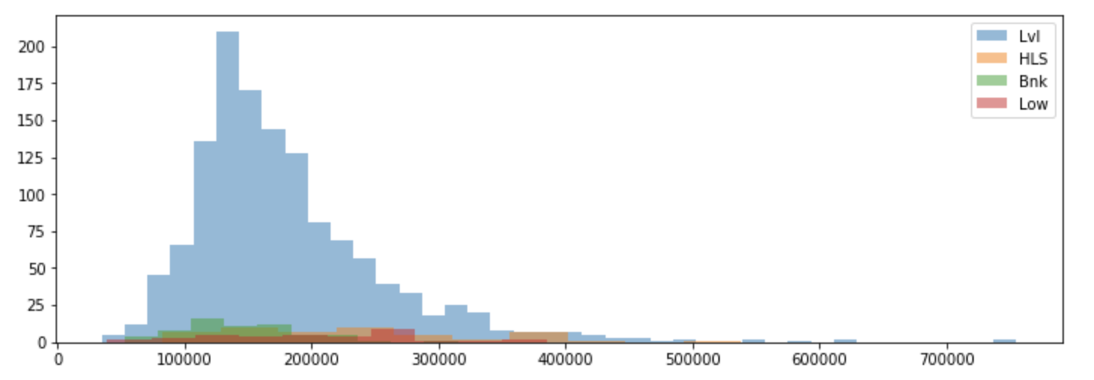
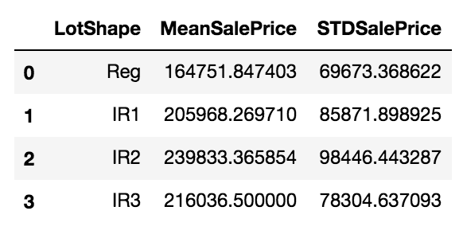
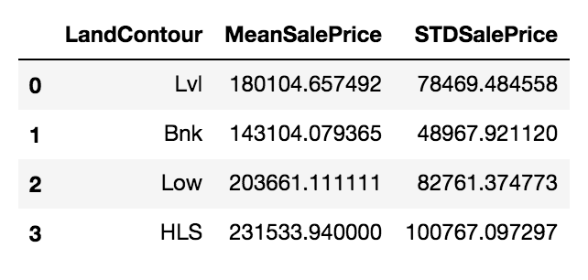
MSZoning
Alley
The counts for each category in MSZoning are to the left in the histogram. Most of the values are ‘RL’ (Residential Low Density).
The other 4 values make up <700 values.
While the majority of values are in one category, I didn’t think it was enough to completely remove MSZoning from the dataset.
This is from the combined_df dataframe.
Above is a histogram of the Alley variable. Because it is so uniform, I decided to throw out the variable as it is not really telling us anything important.
These values are taken from the train_X2 dataframe, as this is the only dataset that has SalePrice in it.
Above is a graph of the average SalePrice regarding each category in MSZoning.
Look at the list to the left and notice the mean sale price (an approximation of the peak of the distribution) and the standard deviation (the spread of the data), you can see that there are definite clusters associated with each of these values. This will be much clearer in other variables as I use sale price histograms to convey this point.
These values are taken from the train_X2 dataframe, as this is the only dataset that has SalePrice in it.
LotShape & LotShapeBinary
LandContour
The counts for each category in the LotShape variable are to the left.
While there is a large amount that are considered Reg, but I did not believe it was uniform enough to throw out.
This is from the combined_df dataframe.
The counts for each category in the LandContour variable.
It is extremely uniform but I decided to check the SalePrice histogram before I decided if I should remove this variable.
This is from the combined_df dataframe.
Above is a histogram of the SalePrice based on each category in LotShape. Notice that the SalePrice for almost all of the Iregular lot shapes (IR1,IR2,IR3) are around the same area, and in fact IR1 and IR2 have peaks very close to each other (~$200,000). I therefore found it appropriate to create a new class for all Irregular lot shapes, called IR. So now, we only have two categories: Reg and IR.
I then created a new column, LotShapeBinary that would further simplify our analysis, where 1 = Reg, and 0 = IR. I then dropped the regular LotShape variable.
These values in the graph are taken from the train_X2 dataframe, but LotShapeBinary was created for the combined_df dataframe.
Above is a histogram of the SalePrice based on each category in LandContour. We can see that Lvl has the most clear peak and its more spread out around the left side of the peak. HLS is the most spread out based on standard deviation. It also doesn’t seem to have a clear peak like Lvl. Bnk appears to have a more clear peak around $100,000 and the standard deviation is much smaller indicating that it’s a clearer cluster. Low appears to have the same problem as HLS as it is spread out extremely thin and there is no clear peak.
Taking all of the above info into account, I decided that LandContour isn’t a very good variable to predict the SalePrice, so I removed the feature.
The SalePrice hist is taken from the train_X2 dataframe.

Slide 11
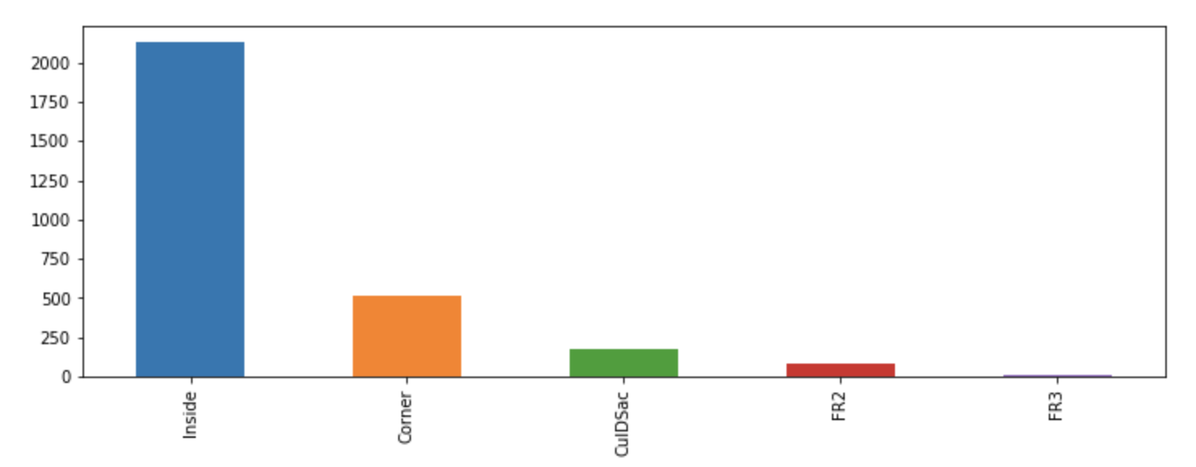
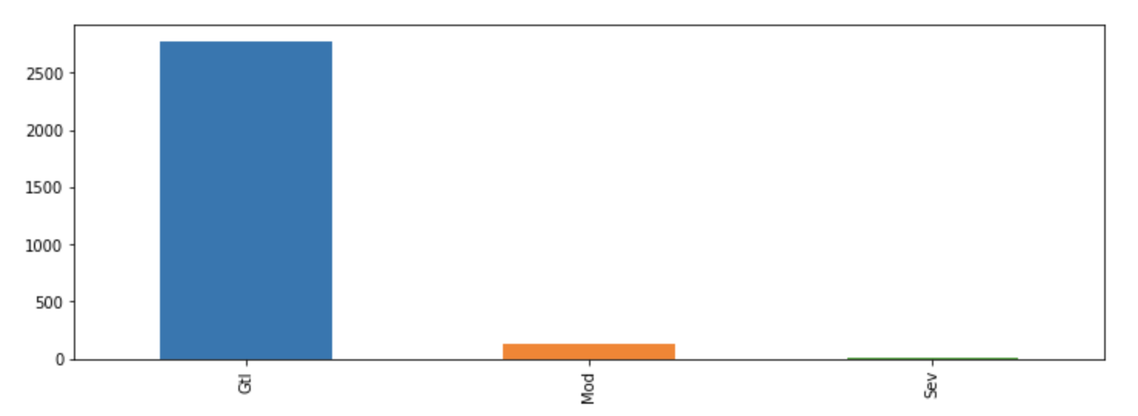
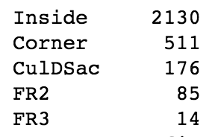
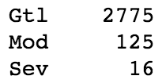
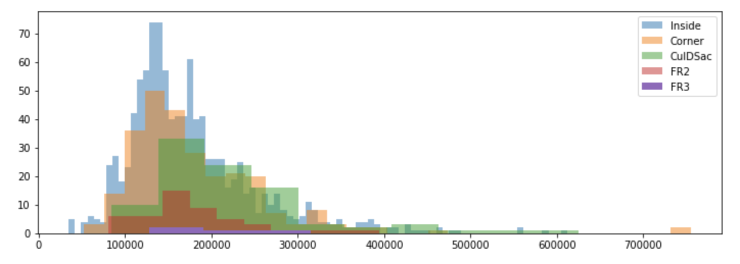
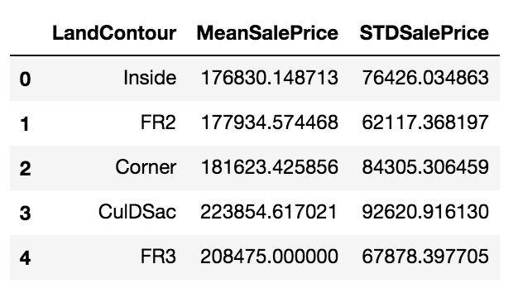
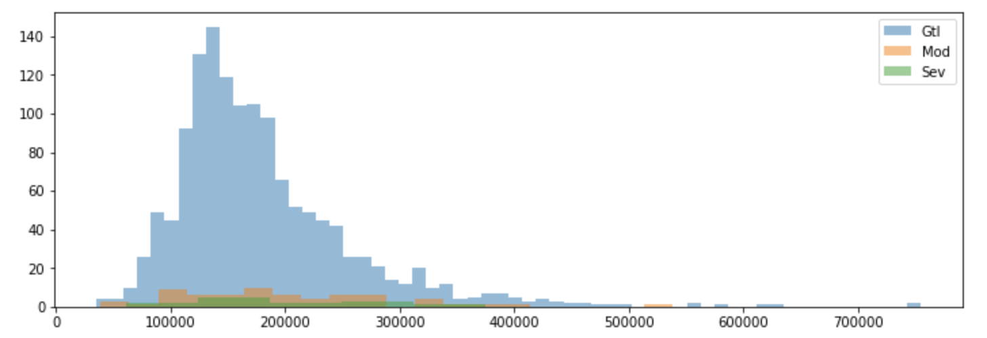
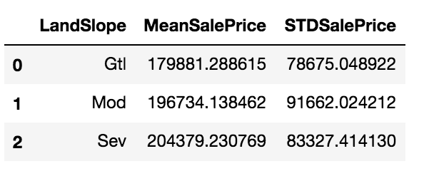
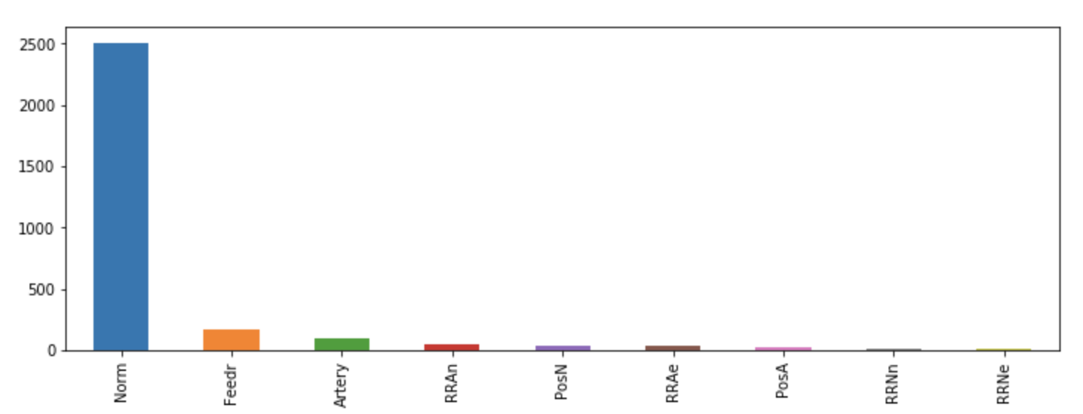
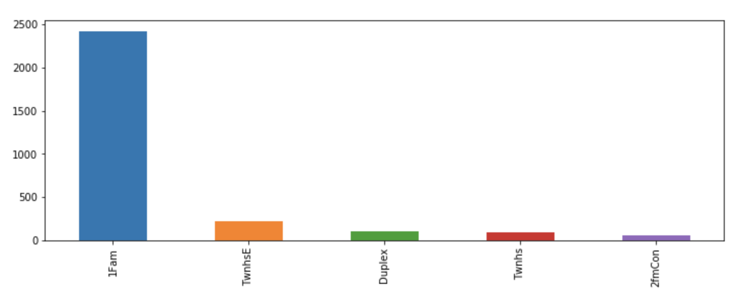
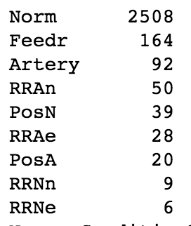
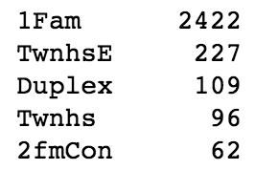
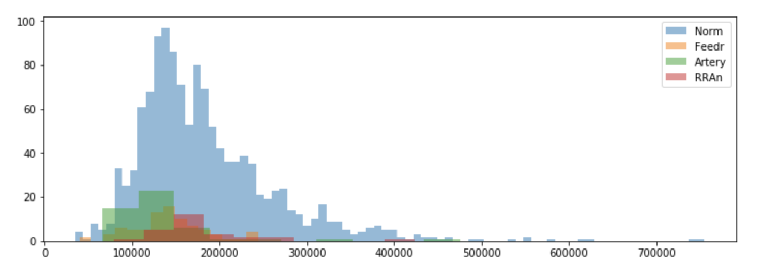
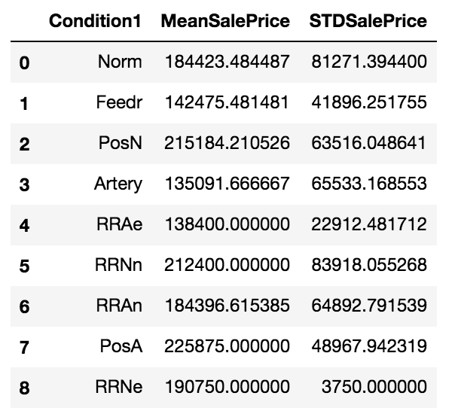
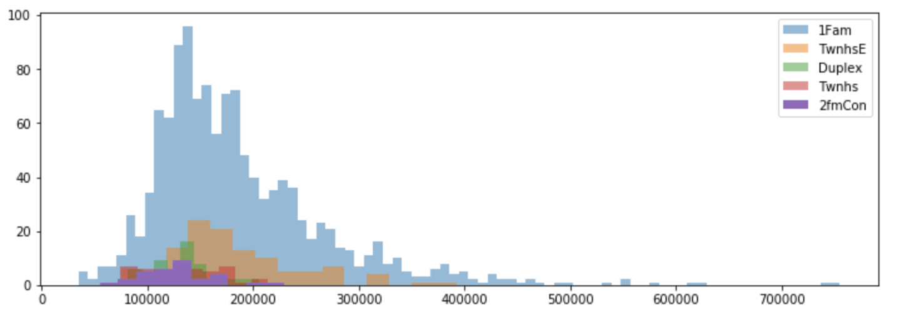
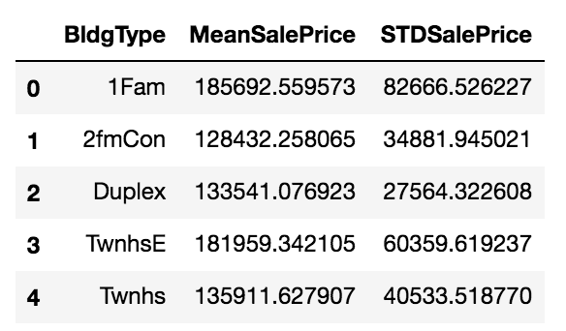
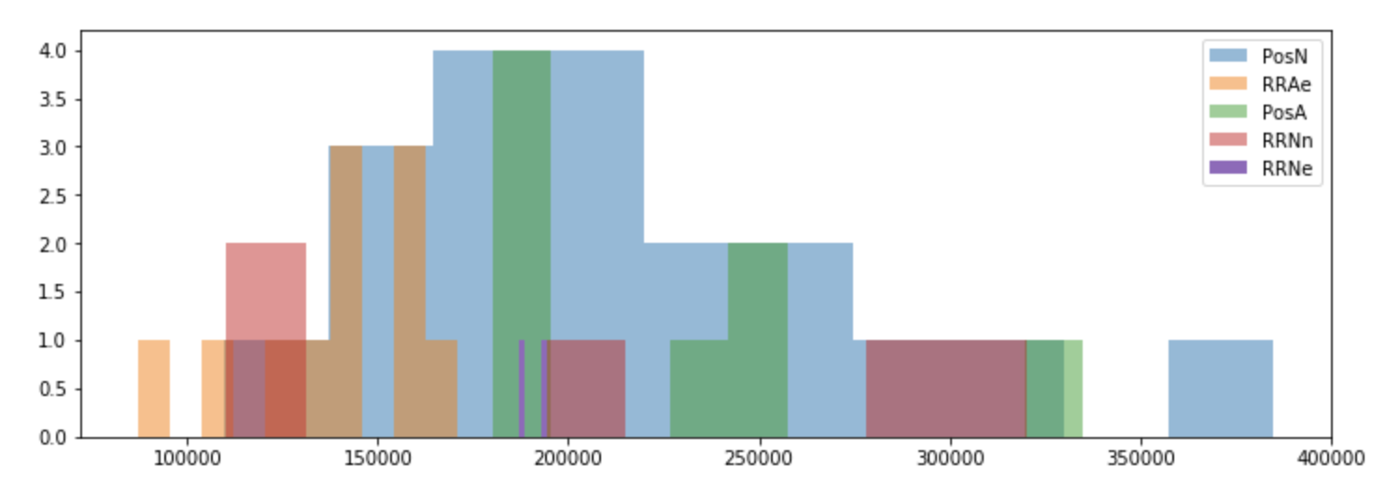
LotConfig
LandSlope
To the left is a histogram of the values in the Lotconfig feature.
There is not enough uniformity in this variable to simply throw it out based on that.
This is taken from the combined_df dataframe.
The above graph shows the distribution of SalePrice based on the different categories in the LotConfig feature.
There are a couple of important features of this graph that are important to point out. The peaks for almost all of the distributions (Inside, Corner, CulDSac, and FR2) peak around the same SalePrice value (~$150,000 - $180,000). FR3 seems to not have a clear peak and seems to be more spread out and flat compared to the others.
It seems relatively clear that there are clear clusters and distributions for the different values of LotConfig, and there isn’t a huge amount of uniformity within this variable, so I decided to keep it.
It appears that a lot of the SalePrice values in FR2 and FR3 are very similar, so I decided to combine both categories to create a single FR category. The new categories are: Inisde, Corner, CulDSac, and FR.
This histogram is taken from the train_X2 dataframe.
The graphs above show the histogram of the values in the LandSlope feature and a SalePrice histogram for each value in the LandSlope feature.
So many values are in one category (Gtl), that it already seems that this variable should be thrown out. I checked the histogram for SalePrice to see if this would be a good idea. The distributions for Mod and Sev seemed to be extremely spread out, and in my opinion wouldn’t be great indicators for SalePrice, so I threw out this variable.
This histogram is taken from the train_X2 dataframe.
Condition1
BldgType
This category shows that this is highly uniform and that there are a lot of categories, so this brings a lot of red flags already.
This was taken from the combined_df dataframe.
This category shows that this is highly uniform, but not uniform enough to throw out on this basis.
There are a good amount of categories, but not enough to throw out on that basis either.
This was taken from the combined_df dataframe.
I created two histograms to see the SalePrice distributions for all categories.
The top histogram shows pretty clear clusters and distributions, however, the bottom histogram shows a much more random distribution.
In the end, I ultimately decided to remove this category because it was too uniform and there were a lot of values that this category can take.
These histograms were taken from the train_X2 dataframe.
I created a histogram to see the SalePrice distributions for all categories in the BldgType feature.
There are very distinctive clusters in this dataset. I thought this would be a fairly good feature, so I decided to keep it without altering the categories in any way.
These histograms were taken from the train_X2 dataframe.

Slide 12
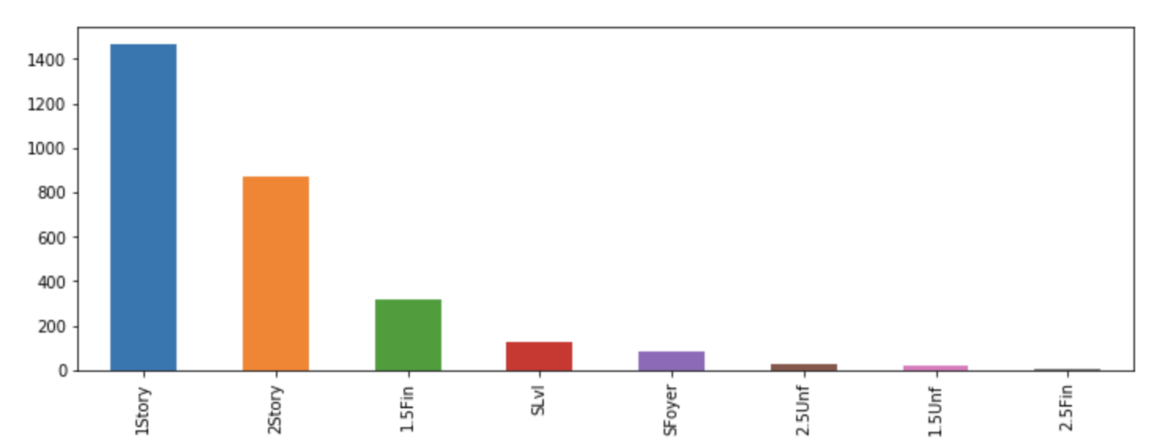
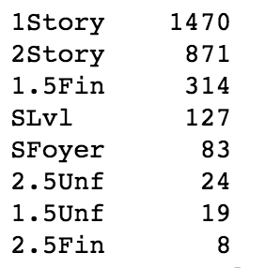
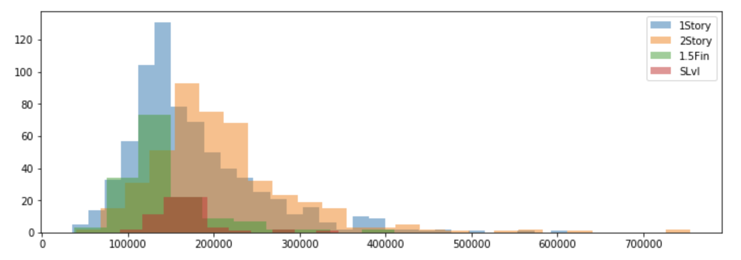












HouseStyle
OverallQual, OverallCond, and OverallRating
The distribution of the HouseStyle values is diverse enough to keep, and not completely uniform.
There are a lot of different values which can put up some red flags.
This was taken from the combined_df dataframe.
These features didn’t require any graphs to look at, I already knew that I wanted to combine these two categories to create a new category.
OverallRating = OverallQual + OverallCond
I dropped OverallQual and OverallCond in favor of OverallRating.
The distribution of the SalePrices from the different values in HouseStyle.
7 of the 8 values (all except 2.5 Fin) have clear clusters and distributions that can be good in identifying the value of houses.
While there are a lot of categories, I couldn’t figure out a clever way to combine some of these categories to reduce the number of categories.
Since these clusters and distributions are pretty distinct depending on the value of HouseStyle. Therefore, I decided to leave the feature the way it is.
These histograms were created from data from train_X2.
Exterior1st and Exterior2nd
BsmtExposure
The distribution across different values for BsmtExposure is pretty good and not concentrated on one value.
This was taken from the combined_df dataframe.
The SalePrice hist shows that each category has a pretty decently defined cluster / distribution. Also, we notice that the better the exposure, the more expensive the house tends to be.
The Gd value tends to be more spread out however, and doesn’t have a clear cluster / distribution as the others.
I decided to keep this feature however despite the unclear distribution of Gd.
This is from the train_X2 dataframe.
I checked the distributions and it is not saturated with one value, so I did not throw it out based on that.
This has the same number of categories as MSSubClass (which I removed because it had too many categories), so I decided to remove both of these features based on that fact alone.

Slide 13



















BsmtFinType1
BsmtFinType2
The values are pretty evenly distributed across all BsmtFinType1 values, and this is a good sign.
Taken from the combined_df dataframe.
This variable seems to be much more concentrated in one value.
Usually this will disqualify this variable and have me remove it, but I plan on coverting this var with BsmtFinType1 into an ordinal number scale and then combining them.
Taken from the combined_df dataframe.
The 2 histograms show the distribution of SalePrice across the different values of BsmtFinType1.
For all 7 values there are pretty distinct clusters and unimodal / bimodal distributions that are distinctive based on the BsmtFinType 1 value.
This variable looks like it can be pretty helpful and because of this I decided to keep it for analysis.
This is taken from the train_X2 dataframe.
The 2 histograms show the distribution of SalePrice across the different values of BsmtFinType2.
For the top histogram, all 4 values tend to have pretty distinctie clusters. GLQ and ALQ have a more spread out distribution.
This is taken from the train_X2 dataframe.
Electrical
Functional
This feature is extremely uniform for SBrkr.
This variable actually clusters well for FuseA and FuseF, but these two values alone can’t prevent this feature from being removed.
Because of this massive uniformity, I decided to remove the variable
This feature is extremely uniform for Typ.
The top histogram shows that the 4 values graphed have pretty distinctive clusters or distributions.
However because of this massive uniformity, I decided to remove the variable
$67,000
$129,000

Slide 14
















BsmtFullBath, BsmtHalfBath, FullBath, HalfBath, BsmtTotBath, & TotBathAbvGrd (w/ TotalBsmtSF)
From combined_df dataframe
There is a positive correlation between SalePrice and FullBath.
The outlier is not in train_X2 dataframe, so it doesn’t show in this graph.
I checked the outlier in the combined_df and there were 4 entries that have FullBath = 4. All 4 houses were huge, so nothing unusual.
Box plot of the different bathroom features. HalfBath doesn’t have any outliers, so I did not bother examining that variable.
I examined the other 3 variables’ outliers to see if there is anything going on that doesn’t make sense.
As you can see, there is almost a negative correlation between SalePrice and BsmtFullBath
Outlier
I checked the outlier in the combined_df and there were 2 entries correlated with this outlier.
Again, these tend to be not as big houses whose redeeming quality is a decently large basement.
From train_X2 dataframe
As you can see, there isn’t a strong correlation with number of HalfBath and SalePrice.
From train_X2 dataframe
I checked these outliers to see why the houses were so cheap as BsmtHalfBath increases.
It appears that these houses tend to have weaker qualities all around but their redeeming qualities are there large basements.
This shows the histogram for the TotalBsmtSF. The 2 entries that are associated with BsmtFullBath = 3 have TotalBsmtSF ~ 1200. As you can see, it is not even close to the largest basement.
There definitely isn’t a strong correlation between BsmtHalfBath and SalePrice. In fact, it almost seems like there is a negative correlation.
Outliers
From combined_df dataframe
From train_X2 dataframe
From train_X2 dataframe
Even though basement bathrooms are negatively correlated with SalePrice, TotalBsmtSF seems to be positively correlated with SalePrice.
To simplify the number of features, I ended up combining certain bathroom features together to simplify the variables.
BsmtTotBath = BsmtFullBath + ½ * BsmtHalfBath
TotBathAbvGrd = FullBath + ½ * HalfBath
BsmtFullBath, BsmtHalfBath, FullBath, and HalfBath were all dropped after this.
This outlier is a brand new unfinished house, and that is why it sold extremely cheap.
BedroomAbvGr
Box plot of the BedroomAbvGr feature.
I checked the entries for the outliers.
The 4 outliers are BAG = 0,5,6,8
From train_X2 dataframe
From combined_df dataframe
This value has a low SalePrice because the house is old as fuck and its not completely up to date electronically.
Histogram of BedroomAbvGr
From combined_df dataframe
Unimodal right skewed distribution of BedroomAbvGr.
Outliers = 0: These houses don’t have bedrooms above grade, but they can have bedrooms in the basement. So, these values aren’t completely illogical.
Outliers = 5,6, & 8: To see if these made sense, I graphed TotRmsAbvGrd vs BedroomAbvGr to see if TotRmsAbvGrd is always larger than BedroomAbvGr, and it is by the bottom graph.
You also can see that there is a generally positive correlation with these two variables.
A scatter plot of SalePrice vs BedroomAbvGr .
As we can see, there isn’t a very strong correlation between the number of rooms and the SalePrice. But, this can probably be attributed to the fact that there are much more houses that have 2,3, and 4 bedrooms that have more redeeming qualities that bring the price of the overall house up.
From combined_df dataframe

Slide 15









KitchenAbvGr
Boxplot of KitchenAbvGr values.
There were 3 outlier values as shown in this boxplot, and I investigated all 3
combined_df dataset
train_X2 dataset
combined_df dataset
I decided to look at the SalePrice vs GrLivArea for KitchenAbvGr = 2 to make sure that this plot makes sense.
There were an abnormal amount of these values and it made it hard to analyze all of them at once, so I decided to create a plot.
As you can see most of these houses have a large amount of SF for GrLivArea (None < 1000).
Of course, there is a positive correlation between SalePrice and GrLivArea.
The vast majority of these values have KitchenAbvGr = 1. I do not think this category should be removed because it is a numerical value, and the other more uniform categories are nominal variables. These nominal variables will get created into one hot category variables, and when they are mostly one value, this will lead to a lot of new one hot category variables with a bunch of zeros. This is not true with numerical variables, so thats why I will still keep this KitchenAbvGr variable.
Outlier = 3: There are only 2 entries for this value, one of the houses is brand new and is incomplete when last examined and the other is an unfinished 2.5 story home. That is why both of these houses have a low sale price.
Outlier = 2: I checked these entries to see if this makes sense. A lot of these entries are duplexes. I searched on Google to see if this is normal, and apparently duplexes with 2 kitchens is not uncommon.
Outlier = 0: There are 3 entries that have KitchenAbvGr = 0. I found that they are functional houses and they tend to be Sfoyer or SLvl. They all 3 have basements and it is possible that they have Kitchens in the basement (as the KitchenQual value is not NA but TA).
train_X2 dataset
TotRmsAbvGr
Boxplot of TotRmsAbvGr
I only checked the top 3 outliers (13,14,15), as the bottom 2 (11,12) have a lot of values based on the blackness of the dots
combined_df dataset
combined_df dataset
Outliers
combined_df dataset
There are only 1 entry for each outlier value that I researched. I checked GrLivArea vs TotRmsAbvGrd to make sure that as the number of rooms go up, the area of above grade living area also goes up, and that is exactly what we see.
I couldn’t look at the saleprices in the train_X2 dataframe because only one of these values is in the train_X2 dataframe and that house is worth $200,000 (outlier = 14), and that is because it is an abnormal sale involving a trade, foreclosure, and short sale.
There is a pretty great spread across all values in the TotRmsAbvGr.
This is a right skewed unimodal distribution.
Notice also that the TotRmsAbvGr = 2 also only has 1 value in the dataset however it falls in the range of the bottom whisker. There is a mathematical equation that dictates the range of the whiskers, and the median being 6 with the bottom of the box being around 5, is what allows the 2 to be picked up by the bottom whisker.

Slide 16













WoodDeckSF, OpenPorchSF, EnclosedPorch, 3SsnPorch, ScreenPorch & combo_porch
HISTOGRAMS
SalePrice vs Porch Feature
From train_X2 dataframe
From combined_df dataframe
These are the SalePrice plots for the different Porch variables.
The top 2 plots (WoodDeckSF and OpenPorchSF) look like they have a more positive correlation with SalePrice. This can probably be attributed to the fact that these 2 porch variables don’t have as many 0’s as the bottom 3 porch variables (EnclosedPorch, 3SsnPorch, ScreenPorch).
These are the histograms for the different Porch variables.
WoodDeckSF has 1522 0 values
OpenPorchSF has 1296 0 values
EnclosedPorch has 2457 0 values
3SsnPorch has 2879 0 values
ScreenPorch has 2660 0 values.
There are 1215 entries that have multiple porches
There are 481 entries that have no porches.
From train_X2 dataframe
From combined_df dataframe
From combined_df dataframe
From train_X2 dataframe
From combined_df dataframe
From train_X2 dataframe
From combined_df dataframe
From train_X2 dataframe
combo_porch
From train_X2 dataframe
From train_X2 dataframe
From combined_df dataframe
I decided to combine all the porch variables together to create the combo_porch variable.
To the left are there SalePrice vs combo_porch graph (top) and the combo_porch histogram that shows the distribution of this variable.
As we can see, this variable has far less 0’s than any of the other porch variables alone, and based on the correlation graphic above, it is more positively correlated with SalePrice than any of the other porch variables by themselves.
Because of this, I added this variable to combined_df and removed the other porch variables.

Slide 17




















PavedDrive
PoolArea
This category is heavily biased for one value.
Taken from the combined_df dataframe
This is a histogram of all PoolArea > 0.
From the value_counts list, we can see there are much more 0 values than the rest.
If PoolArea can show to be substantially correlated with the SalePrice variable, then we will keep it as an indicator of pool ownership (w/out PoolQC).
This is taken from the combined_df dataframe.
All PoolArea values
PoolArea > 0
There are pretty distinct clusters for the SalePrice of the values N and P.
However, given that this variable is extremely uniform and that the Y value seems to take on values from both extremes of the SalePrice value, I do not think this variable will add much to the analysis for this analysis.
This graph was produced from the train_X2 dataframe.
The above graphs represents SalePrice vs PoolArea from the train_X2 dataframe. The first 4 dots show a positive correlation between these variables but the 3 dots in red completely skew this pattern.
There are 2 tables that show the correlation values between PoolArea and SalePrice (This shows the standard Pearson correlation coefficient r).
When we include the 0 PoolArea values, we see that r is very weakly positive. However, when we only use the positive values for PoolArea, we see the correlation is very weakly negative. Given the amount of 0’s and how this variable correlates with SalePrice, I decided to remove it from the dataframe.
Fence
MiscFeature & MiscVal
A bar plot of the different values from the Fence feature, taken from the combined_df dataframe.
Many of the values are in the NA (No Fence) category, but there is a decent enough spread that we cannot throw it out for being too uniform.
To the left are histograms that show the distributions of the SalePrice depending on the MiscFeature variable. These values for the histogram were taken from the train_X2 dataframe, while the value_counts are taken from the combined_df dataframe.
The most common value besides NA, Shed, is pretty spread out across the histogram, while the other values don’t have a well defined distribuition.
I have my doubts about how useful this variable is, so I decided to look at the MiscVal variable as well
To the right is a histogram of the MiscValue variable, without the zero values. Most of the add-ons aren’t that expensive, but some are very expensive.
The MiscVal variable has 2813 0 values instead of 2810 like the MiscFeature variable would indicate. I found this to be an error in the dataset and replaced these values with the mean MiscVal associated with the respective MiscFeature to rectfy this problem.
The bottom scatter plot shows the SalePrice vs MiscVal variable, with a correlation table. Both of these only look at MiscVal > 0 values to get a true assessment of the relationship. It is very weakly correlated with SalePrice.
I decided to throw out both of these features because they don’t add much to the analysis.
Above is the SalePrice histogram that Is split between the Fence values.
We can see that there are some pretty distinctive clusters that form depending on the values that the Fence feature takes. Specifically, we see that MnWw and GdWo tend to be associated with lower value homes, while both Prv values tend to be associated with higher value homes. NA values are all around the spectrum, but this is probably due to the fact that these homes have vastly more counts and have other redeeming qualities that make them more expensive.
Because of all of this, I decided to keep the Fence variable.

Slide 18


















SaleType
SaleCondition
A barplot of the different values in SaleType from the combined_df dataframe.
This variable is fairly uniform but again, not enough to throw away on that alone.
Barplot of the different values for SaleCondition from the combined_df dataframe.
It is pretty uniform but again is spread pretty well across different values.
These are histograms of the SalePrice that are seperated based on the value of SaleType. I had to graph multiple histograms because some of the values are so low that they can’t be seen in the other histograms.
WD and New seem to have pretty well defined distributions (even though the latter is much more spread out). COD also has a decent distribution.
I decided to keep this variable because its an indicator of a pretty important property.
Also notice that all the values that deal with contracts (ConLD, ConLI, ConLw, and Con) are spread around the same values. Because of this, I decided to combine them together into one value, Contract.
These are SalePrice histograms from the train_X2 dataframe.
These values cluster up in certain areas and these make sense. For example, Abnormal sales tend to be associated with lower SalePrice values. This makes sense because Abnormal sales are associated with a financially distressed homeowner that sells there house for less than its worth.
The distribution for Partial sales also make sense because these tend to be newer, larger houses that are being developed however, they are not completely finished. This explains their overall expensive values because of how new they are.
Because of all of this I decided to keep this variable as it can be very helpful to help predict SalePrice values.
MoSold
YrSold
This is a histogram showing the distributions of the MoSold variable from the combined_df dataframe.
We can see that most houses are being sold around the end of spring and beginning of summer, but we can’t tell from this plot alone if this is a good indicator of SalePrice.
The other 2 plots show 1) the SalePrice by MoSold and 2) the mean SalePrice by MoSold with the error bars indicating 1 standard deviation. They were both created from the train_X2 dataframe.
As we can see, there is a lot of variability between months, and the means are all really close together.
The table at the bottom shows the Pearson correlation coefficient of MoSold vs SalePrice. As we can see from the table and the mean SalePrice graph, there isn’t a strong correlation between MoSold and SalePrice.
This variable is not helpful and is removed from the dataset.
This is a histogram showing the distributions of the YrSold variable from the combined_df dataframe. It looks a little weird but the bars closest to the whole number year are supposed to represent sales for that year.
The weakest year is 2010, but that is because the data collection stopped at some point in 2010. We still don’t kmow if a certain year is associated with higher sales or not.
The other 2 plots show 1) the SalePrice by YrSold and 2) the mean SalePrice by YrSold with the error bars indicating 1 standard deviation. They were both created from the train_X2 dataframe.
As we can see, there is a lot of variability between years, and the means are all really close together.
The table at the bottom shows the Pearson correlation coefficient of YrSold vs SalePrice. As we can see from the table and the mean SalePrice graph, there isn’t a strong correlation between YrSold and SalePrice.
This variable is not helpful and is removed from the dataset.

Slide 19

FINISHING TOUCHES
After all appropriate features were removed, added and condensed, I converted all the ordinal variables to a numerical scale and all categorical variables into one hot vectors.
I combined the 3 different sets of Qual and Cond variables left now that they were converted to a numerical scale, and dumped them after they were combined.
The new features added were re-organized to represent their original order (since all new features were appended to the end of the dataframe).
I created a correaltions table of all these variables (now that they are numeric) and saved the file as an excel file.
I split the data into the respective training and test sets, dumped the Id feature, and saved them with the pickle package.

Slide 20
New Functions Summary
SaveFitModels – Takes the predictions from a model from test_X2 data and creates/saves a csv file in a specific directory. This csv file can be submitted on Kaggle and scored.
SplitStandard – Takes our training data, and splits the data into a new training set and a dev set. This function also lets you either 1.) Scale the data (Via StandardScaler, MinMaxScaler, or RobustScaler), 2.) Normalize the data, or 3.) Standardize and Normalize the data. You can also choose to do neither of 1.) – 3.) if you just want the data to be split.
XGBRModelTune – Takes an XGBoost model, XGBoost parameter name, and a range of values for that parameter, and does a parameter search for that model. You can choose to do a randomized search or a grid search. Outputs the model, results of the search, the best param value, and the best score. If you want, you can plot the error score vs the parameter values, and the importance of the features for the current model.
TrainDevTestErrors – Takes a model, fits to a training set, then computes error scores and explained variances on the training, and dev sets. Also can make predictions on a test set and saves them so they can be submitted on Kaggle.
XGBTrainDevComparisons – Takes in a XGBoost model, XGBoost parameter, training sets, and dev sets. Essentially what this function does is it takes an array of different values of a specific XGBoost parameter. We take a parameter and insert it into the XGB model. The model is fit on the training set, and makes predictions on the training and dev sets respectfully so that we can compute error scores and explained variances. After each value of the parameter is tested, the values of the training and dev errors are graphed so that you can visually compare the errors for different parameter values.
TDComp – This function is an complimentary function for XGBTrainDevComparisons. Essentially, this function takes the model results from GridSearchCV or RandomizedSearch and grabs the top n performing values (n being a number that the user defines). Once we have these values, it then converts it into a data structure that can be taken and worked with in XGBTrainDevComparisons.
Standardizer – This essentially works like SplitStandard, however, it doesn’t split the data into a training and dev set.
TrainTestErrors – Essentially works like TrainDevTestErrors, but doesn’t take a dev set.
KNNModelTune – Takes a KNN model, along with a training set and range of values for a given hyperparameter. It then conducts a grid search or randomized grid search with the parameter values and returns the best model, along with the results of the grid search. Also, we graph the parameter value and error to visualize the parameter search.

Slide 21






Random Forest Regressor & Parameter Tuning (Practice for XGBoost)
For this model, I did a pretty basic grid search, and looked at multiple parameters together, as I believed it would make the parameter search better. It wasn’t until I read a chapter from the textbook Automated Machine Learning (Hutter, Kotthoff, and Vanschoren 2019), that I realized it is better to do parameter search one parameter at a time. I will do this with XGBoost, but for now I will walk through my process in this algorithm. The parameters that need to be tuned are: max_features, min_samples_split, n_estimators, max_depth, and min_samples_leaf.
RFR Round 0
Round 0: I used all the default parameter values and ran the function RFRmodelfitCV to gauge the mean squared log error, explained variance, and feature importance of this basic model. I also submitted this models predictions to Kaggle as a baseline. The score we received was 0.15891.
Pictured: Part of a single decision tree that is outputted from the final tuned RFR model. Since RFR is an ensemble method, this is one of the many trees used (approximately 225 because this is what n_estimators signifies) to create the final model.
Round 1: I instantiated two features values: max_features = ‘sqrt’, and min_samples_split = 14. The max_features value is a standard starting value in Machine Learning, and min_samples_split should be around 0.5%-1% of the total number of entries (# of entries = ~1400). I did a randomized grid search on 3 parameters: n_estimators (20 -> 150, steps = 10), max_depth (3 -> 10, steps = 1), and min_samples_leaf (10→ 100, steps = 10). RandomSearchCV randomly samples from all these ranges and tests this combination of parameters and determines the best combo. The dots in the 3D scatter plot are colored by the error from the predictions of the model; the lighter the color, the smaller the error. Clearly we see that higher values of max_depth and n_estimators, combined with lower values of min_samples_leaf produce the better models. I used this insight in order to find better ranges to search through for all 3 parameters in the next round. The best parameter combinations were: n_estimators = 150, max_depth = 9, min_samples_leaf = 10, with mean_squared_log_error ~ -0.0274.
Round 1
Round 2
Round 2: I used the insights from the above scatter plot to develop better ranges to look acrosss for the same 3 variables. For n_estimators, 80 -> 200, steps of 5; for max_depth, 8 -> 14. steps of 1; and for min_samples_leaf, 5 -> 15, steps of 1. GridSearchCV tests all combinations of parameters, hence the graphic on the right. We see that as max_depth, and n_estimators increases, while min_samples_leaf decreases, we reduce the error in our predictions. The best combinations were: n_estimators = 200, max_depth = 13, and min_samples_leaf = 5, with mean_squared_log_error ~ -0.02451 (which is a significant boost). I decided to keep max_depth as that value and switch it with another variable, min_samples_split.
Round 3
Round 3: Now with max_features = ‘sqrt’, and max_depth = 13, I decided to do a parameter search with n_estimators, min_samples_leaf, and min_samples_split. I kept the first 2 because we kept getting the best values at the edges of the ranges given, meaning there are potentially better values to be found beyond those ranges. The updated ranges are: n_estimators (180 -> 250, steps of 5), min_samples_leaf (2 -> 7, steps of 1), and min_samples_split ( 5-> 20, steps of 1). I used a regular parameter gird search, as you can see from the 3D scatter plot to the left. Large values of n_estiomators work well, as well as small values of min_samples_leaf (as we have been seeing). Min_samples_split also seems to do much better for the model when the values are lower. The best combinations were: n_estimators = 225, min_samples_leaf = 2, and min_samples_split = 6, with mean_squared_log_error = -0.0220 (another significant increase). I decided to keep the values for n_estimators and min_samples_leaf (as 2 is the lowest value it can go), but added max_features value to the parameter search for the last round of tuning.
Round 4: For the final round of tuning, I only looked at two variables: min_samples_split and max_features. The ranges for each are as follows: min_samples_split (3 -> 10, steps = 1); max_features (6→ 30, steps of 2). I used GridSearchCV again, and the result is the 2D scatter plot to the left. The dots are a little difficult to see, as they are pretty small, but we can kind of see that as min_samples_split decreases and max_features increases, we get better model accuracy. The best parameters for this search were min_samples_split = 4, and max_features = 26, with mean_squared_log_error = -0.0200. I decided to keep both of these values and stop tuning the model. The final parameter values were max_depth = 13, n_estimators =225, min_samples_leaf = 2, min_samples_split = 4, and max_features = 26. I used this model on the testing data set and submitted the answeres to Kaggle and received a score of 0.14873. Compared to the errors I get on the training data, we can clearly see that I am overfitting to the training data, and decided that I would take a different approach than before when I tune the XGBoost model.
RFR Round 4
NOTE: Try to use size = -1 * mean_squared_log_error for plotly so that the sizes of points vary as well, and they are easier to see.
Round 4

Slide 22

















XGBRegressor + Standardized Train / Dev split
A SAD STORY 😱
INTRO
SalePrice Hist of strain_y
Up to this point, I did not standardize or split the training dataset. I decided to do both at the same time. The reason to standardize the data is obvious; you do it so that the scale and distribution of the data changes such that it becomes much easier to for our models to learn the data as well as making it easier for us to find optimal hyperparameters. However, the reason for the dev set is that I needed to do more error analysis and keep track of errors more to understand what are the problems with my algorithms and whether or not if I’m overfitting to training sets. Technically, we have been splitting the training set into a train and dev set during parameter tuning, but I wanted to hold out an additional set to test the algorithm on to better tune the models. Depending on how the model predicts for certain sets, we can understand better what we need to do and what parameters to change. I used a 70/30 train/Dev split (this Dev set will have a capital D) and randomized the split. For the majority of the tuning process, we graphed the results of the negative mean squared log error of a dev set (The dev set is 1/3 of the new training set, as both functions only take a single training data set) outputted from RandomizedSearch or GridSearchCV to better visualize how these parameters are affecting the models.
SalePrice Hist of sdev_y
PART I
Part I involves tuning the boosting and tree parameters.
Round II – max_depth
Round III – min_child_weight
The graph to the left is the mean dev set error (from 3-fold cross-validation) vs the min_child_weight.
This graph is more sporadic and random than the previous graph, as it seems that there is 2 peaks in the graph (mcw=4, mcw=7).
The higher the mcw is, the more conservative the model will be because the more entries that can be stored in the same leaf node; otherwise, we risk overfitting to the training set.
The best value is mcw = 4. It seems like our initial parameter we selected was the best (we got lucky).
Round I – n_estimators
This parameter was tuned using the function modelfitXGB, which uses an unconventional method to tune n_estimators that is different than the standard method that I use. The other parameters are tuned with RandomizedSearch or GridSearchCV.
I instantiated the following values before I tuned n_estimators: learning_rate=0.1, max_depth=6, min_child_weight=4, gamma=0, subsample=0.6, colsample_bytree=0.109, lambda=1, alpha=0, objective =reg:squarederror, booster=gbtree, seed=20.
The graph to the left is the most important features after tuning n_estimators.
The tuned value for n_estimators = 156.
The graph to the left is the mean dev set error (from 3-fold cross-validation) vs the max_depth.
max_depth = 1 has the worst error rate, as the error is negative mean squared log error (so the lower the value, the farther away from 0, the worse the error is).
We reach a pinnacle at around max_depth = 4, then the error rate gets worse. This makes sense as when the max_depth gets too large, we start overfitting to the training set and generalize poorly to the dev set.
Round IV - gamma
The graphs to the left is the mean dev set error (from 3-fold cross-validation) vs the gamma value. There are 2 grpahs because I had to check two different ranges, because the first range of values I tested showed no difference in the performance of the model.
The first range I tested was range(0,21,1), and we saw no improvements in the model.
I decided to randomly test values between 0.001 – 1 to see if the previous values were too large. It turned out that this also did not make a difference.
I decided to keep the default value of 0 since non of the values made a difference. I have a feeling that this value is only useful to linear boosters. I was using a tree based booster the whole time, so that is one explanation for this behavior.
Round V - subsample
The graph to the left is the mean dev set error (from 3-fold cross-validation) vs the subsample.
This graph has a clear trend that shows that as we increase the subsample size (0-1), the model performs better.
I believe this happens because we are using the new training set (that has 2/3 of the entries of the original training set, which is about ~940 values vs 1400 values). Since we have significantly less rows now, we need to use all of them for this XGBoosting algorithm.
So, I decided to use subsample = 1 for this model.
Note: This also may be why this model didn’t perform well on the test set is because subsample = 1 is ~933 for the training set, but is ~1400 when applied to the test set.
Round VI – colsample_bytree
The graph to the left is the mean dev set error (from 3-fold cross-validation) vs the colsample_bytree (0->1).
This graph was a lot more sporadic as well, just like mcw.
This parameter is a bit tricky because if you don’t look at enough features, you can’t distinguish certain rows from each other based on a handful of parameters. However, if the value is too high or 1, then we start overfitting to the training set.
The best value for colsample_bytree = 0.25 and I decided to use that for my model.
Round VII – n_estimators (BUST)
The graph to the left is the mean dev set error (from 3-fold cross-validation) vs n_estimators.
This was a bust because I didn’t retune learning_rate before. I realized that I need to increase the n_estimators value, then tune the learning_rate between 0.001-1 so that we get a lower value than 0.1.
Round VIII – learning_rate
The graph to the left is the mean dev set error (from 3-fold cross-validation) vs the learning_rate (0.001-1) with n_estimators = 500.
I did a randomized search of the learning_rate across the range 0.001-1.
After a certain threshold, the learning_rate gradually does worse, but not by a lot.
The best learning_rate = 0.04742808 in this model. This makes sense given that we essentially increased the n_estimators from 156 -> 500, and the learning_rate should be decreased by a certain order of magnitude to balance the algorithm.
Round VII (Redux) – n_estimators
The graph to the left is the mean dev set error (from 3-fold cross-validation) vs n_estimators.
I did a GridSearchCV of the n_estimators with a range of range(400,605,5).
We can see that as n_estimators increases, the performance improves.
The best performing value is n_estimators = 595, which is nearly 100 more than the 500 when tuning the learning_rate.
Peak Values
Performance Conclusion
Feature Importance graph to the left.
Training Error = 0.002389
Dev Error = 0.017300040
Test (Kaggle) Error = 0.13939
Score to Beat from 1st Pipeline: 0.12804
Huge gaps in performance between the training, Dev, and test sets suggest that we are HEAVILY overfitting to our training set and possibly the Dev set.
This implies that we need to tune regularization parameters reg_alpha and reg_lambda. This will be done in Part II.
We may have to implement the dart booster if we are still overfitting. This is a neural network technique that implements a dropout technique that doesn’t allow one single tree in the ensemble to have too much weight in trying to predict the sale price.
After we tune reg_lambda and reg_alpha (Part II), we’ll check errors again. In Part III, If we are still overfitting like crazy, then what we can do is grab the top 5/10 values in a parameter search and compare these values on the dev set! That way we can see what values are performing great on the Dev set but maybe not so good on the training set. This will ensure that we aren’t simply overfitting to the training set values, and the dev set that gets created from this training set during a parameter tuning round.
PART II
Part II involves tuning the regularization parameters.
Round II – reg_alpha
Performance Conclusion
Huge gaps in performance between the training, Dev, and test sets suggest that we are still overfitting to the training and possibly Dev set. However, tuning the regularization parameters has improved the ability of our model to generalize to other sets.
Also, we have significantly reduced the test set error from Part II, so that shows how helpful tuning regularization parameters actually is.
Final parameters after Part I and Part II: learning_rate=0.0474, n_estimators=595, max_depth=4, min_child_weight=4, gamma=0, subsample=1, colsample_bytree=0.25, reg_lambda=6, reg_alpha=17.
Round I – reg_lambda
The graph to the left is the mean dev set error (from 3-fold cross-validation) vs lambda values.
I did 2 separate parameter tuning sessions for this parameter; range(1,21,1) and randomized search between 0.001 – 1. The first session outperformed the second session, but I just wanted to check how small values for lambda performed.
Lambda is the constant that is used to control the speed at which the algorithm learns the data; if it learns it too fast then you can overfit to that specific set and not be able to generalize to other sets. The higher the value, the less the model will overfit to the training data.
The best value according to the mean dev set error is lambda = 6.
Feature Importance graph above.
Training Error = 0.00380421
Dev Error = 0.016470693
Test (Kaggle) Error = 0.13490
Score to Beat from 1st Pipeline: 0.12804
The graph to the left is the mean dev set error (from 3-fold cross-validation) vs alpha values.
Alpha has a similar function to lambda and prevents the overfitting as well; however, it is the constant in front of the L1 norm (unlike lambda which is the constant in front of the L2 norm). This one doesn’t affect the learning as much as lambda (because the L2 norm is squared while L1 is not) so we shouldn’t see too huge of a change in the performance based on this fact.
The best value from this parameter tuning session is alpha = 17.

Slide 23

























XGBRegressor + Standardized Train / Dev split
A SAD STORY 😱
PART III
Part III uses drop-out (dart) and we re-tune all the parameters
Round II – max_depth
Round III – min_child_weight
Round I – n_estimators
I used the tuned parameters from the Part I and Part II as the instantiated values.
To the left are 3 graphs: 1.) negative mean squared log error vs. n_estimators, 2.) mean squared log training error vs the top 10 n_estimator values from GridSearch, 3.) mean squared log Dev error vs the top 10 n_estimator values from GridSearch.
From the top graph, we can see that as we increase the n_estimators, the algorithm performs better. The best value from the top graph is n_estimators=642.
The bottom 2 graphs show what the top 10 n_estimator values perform on the training and Dev sets. When we examine these graphs, we see that the value that performs the best on both sets is n_estimators=650. I decided to go with this value instead of the one from the top graph
To the left are 3 graphs: 1.) negative mean squared log error vs. max_depth, 2.) mean squared log training error vs the top 8 max_depth values from GridSearch, 3.) mean squared log Dev error vs the top 8 max_depth values from GridSearch.
The top graph demonstrates that the peak in performance occurs when max_depth=4. The dev error from GridSearch starts getting larger when we increase max_depth because the model overfits to the training set and can’t generalize to the dev set.
The bottom 2 graphs demonstrate a different story. Remember: the errors on these graphs are not negative, so the lower values are performing better. 7 minimizes the Dev set error, but 10 minimizes the training set error. I am more concerned with minimizing the Dev set error, so I chose max_depth=7.
To the left are 3 graphs: 1.) negative mean squared log error vs. min_child_weight, 2.) mean squared log training error vs the top 7 min_child_weight values from GridSearch, 3.) mean squared log Dev error vs the top 7 min_child_weight values from GridSearch.
The top graph shows us that as min_child_weight increases, the algorithm begins to perform better as it doesn’t overfit to the training set. The best performing value is min_child_weight = 14.
The bottom two graphs tell us a different story; 15 minimizes the error for the Dev set, but 7 minimizes the error for the training set. Based off of this info, I decided to keep the 14 value, as it seems like this value is reasonable for both the training and Dev sets.
Round IV – gamma
Round V – subsample
Round VI – colsample_bytree
To the left are 3 graphs: 1.) negative mean squared log error vs. colsample_bytree, 2.) mean squared log training error vs the top 10 colsample_bytree values from GridSearch, 3.) mean squared log Dev error vs the top 10 colsample_bytree values from GridSearch.
The top graph shows a definitive trend; as we increase the colsample_bytree value, the performance of the model gets worse. This makes sense as we can be overfitting to specific features, the more features we use. Also, its possible that even though we feature engineered, some of these features may not be great indicators of SalePrice. The best value from the top graph is colsample_bytree=0.30.
The bottom two garphs show a slightly different story; as we increase the value, it performs better on the training set, but for the Dev set the performance is all over the place. The best value for the training set is 0.55 and the best value for the Dev set is 0.2. I decided to use colsample_bytree=0.2.
To the left are 3 graphs: 1.) negative mean squared log error vs. subsample, 2.) mean squared log training error vs the top 10 subsample values from GridSearch, 3.) mean squared log Dev error vs the top 10 subsample values from GridSearch.
The top graph demonstrates that the best value for subsample is 0.7. The dev error is really all over the place and there is no real trend given the errors for all the other values.
The bottom 2 graphs show a slightly different story; for the training set, the best subsample value is 0.9, and for the Dev set, the best subsample value is 0.85. Since I am more focused to minimize the dev set error, I decided to choose subsample=0.85.
Above is a single graph for the gamma hyper-parameter. As you can see, the value of gamma has no bearing on the performance of the model. So I decided to just keep the default value of gamma = 0.
Round VII – lambda
Round VIII – alpha
Round IX – learning_rate
To the left are 3 graphs: 1.) negative mean squared log error vs. lambda, 2.) mean squared log training error vs the top 10 lambda values from GridSearch, 3.) mean squared log Dev error vs the top 10 lambda values from GridSearch.
The top graph shows that there is no real pattern for lambda and the performance of the model, as values are all over the place. Too low values offer nearly no regularization effect, but if its too high, then you can be over correcting the algorithm too much. The best value is lambda=9.
The bottom 2 graphs have a clearer pattern; the training error is positively correlated with lambda, while the Dev set error is all over the place. Lambda=3 reduces the training error, while lambda=11 reduces the Dev error. Again, since I am more focused on the Dev error, I chose lambda=11.
To the left are 3 graphs: 1.) negative mean squared log error vs. alpha, 2.) mean squared log training error vs the top 5 alpha values from GridSearch, 3.) mean squared log Dev error vs the top 5 alpha values from GridSearch.
The top graph shows that alpha increases performance up to a certain point, then it decreases the performance. The best value according to alpha=5.
Both the bottom graph show a clear relationship between alpha and model error. Training error is positively correlated with alpha, and Dev error is negatively correlated with alpha. Alpha=1 achieved the best performance for the training set, and alpha=5 achieved the best performance for the Dev set. I decided to compromise and use alpha=4, so as not to over fit to the Dev set.
To the left are 3 graphs: 1.) negative mean squared log error vs. learning_rate, 2.) mean squared log training error vs the top ~20 learning_rate values from RandomizedSearch, 3.) mean squared log Dev error vs the top ~20 learning_rate values from RandomizedSearch.
The top graph shows that really small values of learning_rate are terrible on the performance of the model, but after a while it skyrockets up. After that, the performance does a little bit worse as we increase the learning_rate. The best learning_rate is 0.03359277
The bottom 2 graphs tell different stories. The training set does better with larger learning_rates, but the dev set does better with smaller learning_rates. I chose a learning_rate that is better for the dev set than for the training set. The value I chose is learning_rate=0.02467365.

Slide 24

XGBRegressor + Standardized Train / Dev split
A SAD STORY 😱
Performance Conclusion
Feature Importance graph.
Training Error = 0.005832
Dev Error = 0.016767836
Test (Kaggle) Error = 0.13306
Score to Beat from 1st Pipeline: 0.12804
Final parameter values: learning_rate=0.02467365, n_estimators=650, max_depth=7, min_child_weight=14, subsample=0.85, colsample_bytree=0.2, lambda=11, alpha=4, objective=‘reg:squarederror’, booster=‘dart’, seed=20.
After running this experiment, we see that we haven’t beat the score from the 1st data pipeline, even after we cleaned up our data significantly. Personally, I believe that the main problem is splitting the data between a train and Dev set before I parameter tuned. When we do RandomizedSearch or GridSearch, the function is already doing a 3-fold cross validation parameter search, which is already splitting our data into train and dev set. This dataset is only ~1400 entries and is really too small to be splitting our data. I also. Believe that I was overfitting to the Dev set, because I kept picking values for parameters that were best for that set but not really concerned about how it performed on the training set.
Moving forward, this is what I did:
Simply standardize the train and test sets, but not split the training set into a training and Dev set.
Re-tune the XGBoost model.
Keep track of the error from RandomizedSearch or GridSearch. This will be the dev set error. Fitting on training data, then using strain_X2 to predict the training error. The Kaggle score will still be the test error.
Re-organize and create new functions that don’t require a dev set. Sill keep the old ones just in case, but copy them & remove parts dealing with the dev set.

Slide 25










XGBRegressor + Standardized Training Set
A HAPPY STORY 😁
PART I
Part I involves tuning the boosting , tree, and regularization parameters.
Round II – max_depth
Round III – min_child_weight
Round I – n_estimators
The graph above is the mean dev set error (from 3-fold cross-validation) vs the n_estimators values.
Here we can see that as we increase n_estimators the model performs better. However, up to a certain point, the model performs approximately the same.
I instantiated the following values before I tuned n_estimators: learning_rate=0.1, max_depth=5, min_child_weight=3, gamma=0, subsample=0.6, colsample_bytree=0.109, lambda=1, alpha=0, objective =reg:squarederror, booster=gbtree, seed=7.
The tuned value for n_estimators = 240.
The graph to above is the mean dev set error (from 3-fold cross-validation) vs the max_depth.
max_depth = 11 has the worse error rate. This makes sense as the higher the max_depth, the more it overfits to the training set and can’t generalize to the dev set.
We reach a pinnacle at around max_depth = 4.
The graph above is the mean dev set error (from 3-fold cross-validation) vs the min_child_weight.
This graph is more sporadic and random than the previous graph.
The higher the mcw is, the more conservative the model will be because the more entries that can be stored in the same leaf node; otherwise, we risk overfitting to the training set.
The best value is mcw = 4.
Round IV - gamma
Round V - subsample
Round VI – colsample_bytree
I did not save the graph from this because gamma has no bearing on the algorithm so I didn’t bother saving the graph.
I tested the following values: [0,1,5,10,20,50,100].
I decided to keep the default value of 0 since non of the values made a difference. I have a feeling that this value is only useful to linear boosters. I was using a tree based booster the whole time, so that is one explanation for this behavior.
The graph above is the mean dev set error (from 3-fold cross-validation) vs the subsample.
This graph has a clear trend that shows that as we increase the subsample size (0-1), the model performs better. This makes sense, as the more data that gets introduced to the model, the better the model can create individual trees for the ensemble.
So, I decided to use subsample = 1 for this model.
The graph above is the mean dev set error (from 3-fold cross-validation) vs the colsample_bytree (0->1).
This graph wasn’t as sporadic as previous parameter tunes, and it looks like as we increase the value, the model performs better.
The best value for colsample_bytree = 1 and I decided to use that for my model. I believe this is good because we have a whole range of features that we can look at to determine SalePrice.
Round VII – lambda
Round VIII – alpha
Round IX – learning_rate
The graph above is the mean dev set error (from 3-fold cross-validation) vs lambda.
This graph is a little sporadic, but it seems that the performance decreases significantly after the 1-value. There is an increase of performance after lambda=3.
I decided to use the value lambda=1.
The graph above is the mean dev set error (from 3-fold cross-validation) vs alpha.
We can see that as alpha increases, the performance improves up to a certain point, then the performance goes down.
The best performing values are alpha=11 and 12, but I decided to go with 11 sine that was the recommended value of the results.
The graph above is the mean dev set error (from 3-fold cross-validation) vs the learning_rate (0.001-1) with n_estimators = 400.
I did a randomized search of the learning_rate across the range 0.001-1.
After a certain threshold, the learning_rate gradually does worse, but not by a lot.
The best learning_rate = 0.04097649 in this model. This makes sense given that we essentially increased the n_estimators to 400, and the learning_rate should be decreased by a certain order of magnitude to balance the algorithm.
Performance Conclusion
Huge gaps in performance between the training, Dev, and test sets suggest that we are HEAVILY overfitting to our training set and possibly the Dev set.
This implies that we need to tune regularization parameters reg_alpha and reg_lambda. This will be done in Part II. Also, there are other parameters we can tune to help us with overfitting to the training set such as learning_rate, n_estimators, max_depth, colsample_bytree, and subsample.
We may have to implement the dart booster if we are still overfitting. This is a neural network technique that implements a dropout technique that doesn’t allow one single tree in the ensemble to have too much weight in trying to predict the sale price.
After we tune reg_lambda and reg_alpha (Part II), along with other parameters, we’ll check errors again. If things are still going bad, then we can implement drop out to see if that will help with overfitting.
This model performed absolutely terrible, it did worse than the previous Part I model.
Feature Importance graph.
Training Error = 0.00451139
Dev Error = 0.01707068
Test (Kaggle) Error = 0.14024
Score to Beat from 1st Pipeline: 0.12804

Slide 26









XGBRegressor + Standardized Training Set
A HAPPY STORY 😁
PART II
Part II involves tuning parameters that can prevent overfitting to the training set
Round II – n_estimators
Round III – max_depth
Round I – learning_rate
The graph above shows the negative mean log squared error (3 fold cross-validation) vs n_estimators.
With a very small learning_rate, I wanted to try large values for n_estimators. There are basically 2 peaks in this graph, then after the second peak the performance begins to suffer.
The best value is n_estimators=1280.
The graph above shows the negative mean log squared error (3 fold cross-validation) vs max_depth.
From this graph, we can see that the performance is best around 3-4, then the performance begins to suffer.
From this point on, I employed a new strategy to test how well these parameters work with generalizing to other sets. So I grabbed a couple of max_depth values that were tested (and therefore we have mean dev set errors that we can use to compare as well) and tested them on the training set and test set. That way, we can see what values are overfitting to the training set/ dev set, and see if we can generalize better to the test set. In hindsight, this was not the greatest move because technically, we can be overfitting to the test set if we only pick values that are fitting well to the test set.
I tested the max_depth values of 4,6, and 8. These are the results:
Max_depth=4, training error=0.002706866, dev error=0.0172488806, test error=0.13928
Max_depth=6, training error=0.000486761, dev error=0.018482, test error=0.13702
Max_depth=8, training error=0.000136999, dev error=0.018912, test error=0.13747
I decided to go with the max_depth=6 value since it gave me the lowest value for the test_error.
The graph above shows the negative mean log squared error (3 fold cross-validation) vs learning_rate with n_estimators=1000.
The performance peaks around 0.01-0.03, then the performance suffers after that.
The learning rate that performed the best is learning_rate=0.02156731032878086.
Round IV - lambda
Round V – colsample_bytree
Round VI – subsample
The graph above shows the negative mean log squared error (3 fold cross-validation) vs lambda.
The general trend is that the performance increases as we increase the value of lambda.
I took this idea, and tested it on the test set to see which values were the best for the test set performance.
I tested 2 values: lambda=6 and lambda=12. Here are the results:
Lambda=6, training error=0.00377984, dev error=0.017857, test error=0.13678
Lambda=12, training error=0.0047876459, dev error=0.017325, test error=0.13216
I decided to go with lambda=12 because this was the recommended value from the above graph and it performed significantly better than the other value I tested. I used lambda = 12 from this point on.
The graph above shows the negative mean log squared error (3 fold cross-validation) vs colsample_bytree.
The performance increases up to a point, then the performance stays stagnant from that point on.
I was glad that it did not return a 1 like the last parameter tuning, because from my research, using all features is usually never the best option, so at this point I believe that my parameter tuning is going well.
I did not test multiple values for this, and I just accepted the value that was the best for the dev set error.
The best value according to the parameter tuning is colsample_bytree=0.29.
The graph above shows the negative mean log squared error (3 fold cross-validation) vs subsample.
There is a somewhat trend that as we increase the subsample size, the performance gets better, but it is still somewhat sporadic.
Again, the parameter tuning returns a value of 1, but I had a feeling that this wasn’t right.
I decided to test multiple values of subsample to see what would work best for the test set. I tried 3 values: 1, 0.66, and 0.5. My intuition was that since when we do the 3 fold cross-validation parameter tuning, the training set is only 2/3 of the entire set (~900 values). So, since the parameter tuning process returned subsample=1, I thought that it realistically only wanted 2/3 of the values.
Here are the results from the test:
Subsample=1, training error=0.002846854, dev error=0.16623, test error=0.1297
Subsample=0.66, training error=0.0033917, dev error=0.017174, test error=0.12886
Subsample=0.5, training error=0.00398655, dev error=0.017406, test error=0.12932
I decided to use the value subsample=0.66 because it performed best on the test set.
Round VII - alpha
Round VIII – min_child_weight
Performance Conclusion
Training Error = 0.00366238
Dev Error = 0.017382
Test (Kaggle) Error = 0.12825
Score to Beat from 1st Pipeline: 0.12804
Testing different values on the test set is very helpful because you can see what values work the best on the test set.
There are some things that are good with this approach but also not good in general. Let me outline them:
You get to figure out which values are best for overfitting to a training set, dev set, or a test set. Then you can change values that are conducive to the results that you want.
By choosing the values that are best for the test set, and constantly checking your performance on the test set, there is a chance we are overfitting to the test set and it is not conducive to generalizing to other sets. I think an answer to this problem is to increase the value of the n-fold cross-validation parameter search from 3 to a higher value like 10. This increases the size of the training set, decrease the size of the dev set and also you do much more checks (3 -> 10) to see which values are the best.
The final parameter values are: learning_rate=0.0215673, n_estimators=1280, max_depth=6, min_child_weight=5, gamma=0, subsample=0.66, colsample_bytree=0.29, lambda=12, alpha=11, objective=‘reg:squarederror’.
The graph above shows the negative mean log squared error (3 fold cross-validation) vs alpha.
There isn’t reallly a pattern here, which is similar to the last alpha graphs. Because of this, I decided to try multiple values on the test set to see which one was the best.
Here are the results:
Alpha=8, training error=0.003352137, dev error=0.01717395, test error=0.12932
Alpha=5, training error=0.003361089, dev error=0.017191, test error=0.12922
Alpha=13, training error=0.00334662, dev error=0.017185, test error=0.1289
None of these values have tested better than alpha=11, so I left that value in the model.
The graph above shows the negative mean log squared error (3 fold cross-validation) vs min_child_weight.
As we increase the value, the performance falls and doesn’t do so good.
I don’t trust 1 being the best value for this model so I decided to test a couple of values to see what happens.
Here are the results on the test sets:
Min_child_weight=1, training error=0.00244017, dev error=0.016482, test error=0.13
Min_child_weight=5, training error=0.00366238, dev error=0.017382, test error=0.12825
Min_child_weight=8, training error=0.00454258, dev error=0.017594, test error=0.12992
Min_child_weight=3, training error=0.00294866, dev error=0.016944, test error=0.12936
Min_child_weight=6, training error=0.00398693, dev error=0.017475, test error=0.13022
I decided to use the value min_child_weight=5 because it performed the best on the test set.

Slide 27








XGBRegressor + Standardized Training Set
A HAPPY STORY 😁
PART III
Part III involves using the dart booster retuning certain parameters
Round II – max_depth
Round III – min_child_weight
Round I – n_estimators
The graph above shows the negative mean log squared error (3 fold cross-validation) vs max_depth.
This is another parameter that is used to control overfitting, so I tuned it once again.
The best value according to the parameter search is max_depth=5, but I decided to try a couple of values on the test set to see which one is the best.
Here are the results:
Max_depth=5, training error=0.005877125, dev error=0.017291, test error=0.12953
Max_depth=6, training error=0.004626498, dev error=0.017292, test error=0.12987
Max_depth=4, training error=0.007560471, dev error=0.017311, test error=0.12946
I decided to go with max_depth=4 value because it performed the best on the test set.
The graph above shows the negative mean log squared error (3 fold cross-validation) vs n_estimators.
The performance peaks in the beginning and around the middle, then the performance begins to suffer.
The best performing value is n_estimators=1030, which is significantly different from the previous value in Part II, which was 1280.
The graph above shows the negative mean log squared error (3 fold cross-validation) vs min_child_weight.
From this graph, we can see that the performance is best in the beginning, then the performance begins to suffer.
I decided to test out a few values on the test set to see if min_child_weight=1 is overfitting to the dev set.
Here are the results from testing on test set:
Min_child_weight=1, training error=0.00653417, dev error=0.016503, test error=0.12802
Min_child_weight=3, training error=0.00703057, dev error=0.017085, test error=0.12822
Min_child_weight=2, training error=0.00669083, dev error=0.016856, test error=0.12905
I decided to go with min_child_weight=1 since it performed the best on the test set.
Round IV - lambda
Round V – alpha
Round VI – learning_rate
The graph above shows the negative mean log squared error (3 fold cross-validation) vs learning_rate with n_estimators=1500.
I checked values between 0.001-0.1 because any values above 0.1 would give us an error.
I tested a bunch of values to see what would work the best on the test set. Below are the results of the testing.
The graph above shows the negative mean log squared error (3 fold cross-validation) vs lambda.
The general trend is that the performance decreases as we increase the value of lambda. The best value is lambda=2 for the dev set.
I tested a bunch of values of lambda. Here are the results:
Lambda=2, training error=0.0043966, dev error=0.016158, test error=0.135
Lambda=8, training error=0.0060296, dev error=0.016529, test error=0.13095
Lambda=14, training error=0.006762, dev error=0.016563, test error=0.1273
Lambda=17, training error=0.006907, dev error=0.016666, test error=0.12624
Lambda=20, training error=0.007067, dev error=0.016577, test error=0.12507
Lambda=23, training error=0.007221, dev error=0.016803, test error=0.12385
Lambda=26, training error=0.007394, dev error=0.016642, test error=0.12411
I used lambda = 23 from this point on.
The graph above shows the negative mean log squared error (3 fold cross-validation) vs alpha
The performance increases up to a point, then the performance starts to suffer. The recommended value from the tuning is alpha=9.
I decided to test a bunch of values on the test set to see if we could get improvements like we did for lambda. Here are the results:
Alpha=9, training error=0.0072212, dev error=0.016802, test error=0.12385
Alpha=3, training error=0.0072212, dev error=0.016804, test error=0.12385
Alpha=14, training error=0.007221, dev error=0.016804, test error=0.12385
Alpha=23, training error=0.007221, dev error=0.016825, test error=0.12385
None of these values changed the test set error, so I just kept the recommended value of alpha = 9.
Learning_rate=0.037476, training error=0.003825, dev error=0.016285, test error=0.12579
Learning_rate=0.00299649, training error=0.013349, dev error=0.021091, test error=0.14059
Learning_rate=0.0587534, training error=0.0020600, dev error=0.016745, test error=0.12822
Learning_rate=0.0964492, training error=0.0006750, dev error=0.017835, test error=0.13379
Learning_rate=0.02156731032878086, training error=0.0058738, test error=0.12299
Learning_rate=0.020555, training error=0.0061145, test error=0.12282
Learning_rate=0.019756, training error=0.0062454, test error=0.12355
Learning_rate=0.018776, training error=0.0064167, test error=0.12374
Learning_rate=0.020100, training error=0.0062174, test error=0.12355
I decided to use the value learning_rate=0.02055 because it performed so well on the test set.
I also slightly tuned n_estimators again, and the best value was n_estimators=1600.
Performance Conclusion
CLOSING THOUGHTS
Training Error = 0.0058683799
Dev Error = NA
Test (Kaggle) Error = 0.12281
Score to Beat from 1st Pipeline: 0.12804
XGBoost is the best performing algorithm so far, and it has a plethora of hyper-parameters that can be tuned and help us fix problems like overfitting and such.
There are a couple of items I want to highlight however about things that I believe I could have improved on:
I believe the value I put for the n-fold cross-validation was much too low (The value I chose was 3). This is my reasoning essentially; If we increase the value, we increase the size of our training set, with the one draw back being that we simultaneously decrease the size of our dev set. However, this increases the number of rounds we perform on the set when we parameter tune, and we take the mean of the performance across the dev sets anyway, so in the end the decreasing of the size of the dev set isn’t the worse problem. If we increase the value of n, I believe we will get a better idea of how that parameter is performing, and we will get a better idea of which parameters are overfitting to the training set and dev set respectively. Moving forward I will use higher values when I do a grid search.
I’m still confused about when the appropriate time is to test your model on the test set. I am trying to get the best possible test score that I can get, and therefore, I find it appropriate to check my model on the test set frequently, that way I can get an idea of what my model is doing, and compare the different errors with each other. However, I fear that I am actually overfitting to the test set when I do this. The models still perform exceptionally well on the training and dev sets however, so I am not sure if what I am doing is technically overfitting to the test set, since the errors are orders of magnitude different. I would be curious how my model would perform on completely new data, as that would be a real indicator of what sets we’re overfitting to.
Overall, I’m extremely happy with how this turned out, and I significantly reduced the error. I am actually learning how to do machine learning and its an awesome feeling!
Final parameters: learning_rate=0.020555, n_estimators=1600, max_depth=4, min_child_weight=1, colsample_bytree=0.29, subsample=0.66, lambda=23, alpha=9, booster=dart, objective=reg:squarederror, seed=7
We finally beat the score of the previous pipeline by a large margin. Tuning the dart model, and especially the lambda parameter, helped to greatly reduce overfitting on the training set, and generalizing to the test set.

Slide 28

(2/10/20) – Validating my Feature Engineering Choices
All the slides between this one and the one to the golden pipeline slide cover my efforts in validating my feature engineering choices for Data Pipeline 2.
In order to prove that my decisions were good, I need to train an XGBoost well in pipeline 1. My methods for training models has developed since I created pipeline 1, so I need to apply them in this pipeline to confirm that pipeline 2 actually performs better.
Here are a list of things I did differently in pipeline 2 vs pipeline 1:
I paid more attention to the errors on predictions of the training set vs errors on the predictions of the dev set vs errors on predictions of the test set.
I used my knowledge of the 3 different errors in order to pick which parameters I need to re-tune.
I understood that the primary problem that I faced was that of overfitting to the training sets and dev sets, and the models were not generalizing well to the test sets because of this.
I started testing different parameter values on the test set directly and testing how different values improved the test accuracy but decreased the other accuracies. This is generally not a good strategy at all because it can be akin to cheating by teaching your algorithm to over fit to the test set. This is generally true, as one should learn to use the training and dev sets together to produce a good model. But I used this method on pipeline 2 and must do it to some extent for pipeline 1 to validate my feature engineering.
The data that is used is also standardized, just like it was in pipeline 2. This should also be taken into account when understanding how the model performs during this parameter tuning session.

Slide 29










XGBOOST PT. 1
Rounds I – III: n_estimators, max_depth, and min_child_weight
Rounds IV – VI: gamma, subsample, and colsample_bytree
These are the starting parameters I chose: learning_rate = 0.1, max_depth = 5, min_child_weight = 4, gamma = 0, subsample = 0.6, colsample_bytree = 16.155, reg_lambda = 1, reg_alpha = 0, objective = reg:squarederror, booster = gbtree, seed = 7.
These graphs depict the first 3 rounds of parameter tuning the XGBoost model. I tuned n_estimators, max_depth, and min_child_weight.
The graphs are the dev set error vs the parameter values. The error is negative, so the best parameters are around the peaks on the graph. During the parameter searching process, the number of folds in the cross-validation search is 3.
In Round I, I tuned the n_estimators parameter. We can see that the model performs better as we increase the value, and peaks around 330. This value is fairly low and makes sense given the fairly large learning_rate value.
In Round II, I tuned the max_depth parameter. The model’s performance peaks around max_depth=4. Now that I think about it, this value potentially works because it may over fit to the values on the dev sets, but perform poorly on the test sets.
In Round III, I tuned the min_child_weight parameter. The best performing value is 1, which implies that it is overfitting to the training and dev sets. This parameter definitely needs to change in the next part.
The graphs depict the next 3 rounds of parameter tuning the XGBoost model. I tuned gamma, subsample, and colsample_bytree.
The graphs are the dev set error vs the parameter values. The error is negative, so the best parameters are around the peaks on the graph. During the parameter searching process, the number of folds in the cross-validation search is 3.
In Round IV, I tuned the gamma parameter. This parameter never affects the model (as per usual), so we leave the gamma value as its default (0)
In Round V, I tuned the subsample parameter. The model’s performance does better as we increase the parameter value all the way until we reach the last value, 1. When we do cross-validation serach, the training set makes up 2/3 of the original training set and the dev set is 1/3 of the original training set. Subsample = 1 implies that we look at the entire new training set. In reality, we are actually looking at 2/3 of the training set every time. Therefore, in the final run, we will set this parameter to 0.66 to take into account this fact.
In Round VI, I tuned the colsample_bytree parameter. The model performs the best around 0.46. This is good as this imparts randomness on our model when we don’t look at a small portion of columns. This should help us generalize the model to the test set.
n_estimators = 330
MSLE = -0.01968211
gamma = 0
MSLE = -0.01833506 (No improvement)
max_depth = 4
MSLE = -0.0194311
subsample = 1
MSLE = -0.017444306
min_child_weight = 1
MSLE = -0.01833506
colsample_bytree = 0.46
MSLE = -0.0154955
Training Error = 0.002402891
Dev Error = 0.01544
Test (Kaggle) Error = 0.12355
Score to Beat from 2nd Pipeline: 0.12281
Rounds VII – IX: reg_lambda, reg_alpha, and learning_rate
reg_lambda = 1
MSLE = -0.0154955 (No Improvement)
reg_alpha = 1
MSLE = -0.0154951
learning_rate = 0.0248527
n_estimators = 1000
MSLE = -0.0154400
The graphs depict the final 3 rounds of parameter tuning the XGBoost model in Part I, as well as the feature importances for the final model. I tuned reg_lambda, reg_alpha, and learning_rate.
The graphs are the dev set error vs the parameter values. The error is negative, so the best parameters are around the peaks on the graph. During the parameter searching process, the number of folds in the cross-validation search is 3. Also, I plotted the 30 most important features of the tuned model.
In Round VII, I tuned the reg_lambda parameter. This parameter ensures that the model doesn't learn too fast. Since the model peaked at 1, we know this is definitely a parameter that we can re-tune in the next part.
In Round VIII, I tuned the reg_alpha parameter. The model’s performance does best around the beginning of the graph and drops off as we increase the alpha value. It has changed from the default value from 0, but I will consider tuning it later on in the next part to help with regularization.
In Round IX, I tuned the learning_rate. When tuning the learning_rate, we make sure first to increase the number of n_estimators to 1000, so that we can use a smaller learning_rate value, which will hopefully improve the model. I did a RandomizedCV Search, and searched a bunch of values between 0.001 to 0.1. The best learning_rate value is 0.0248527.
The final parameter values are learning_rate = 0.0248527, n_estimators = 1000, max_depth = 4, subsample = 0.66, colsample_bytree = 0.46, objective = ‘reg:squarederror’, seed=7, reg_alpha = 1, reg_lambda = 1.
This model performed phenomenally well for being in the first pipeline, and having some very basic parameters that can be improved. If I were to predict what is going to happen moving forward, then I would think that this pipeline may actually outperform my previous pipeline.

Slide 30










XGBOOST PT. 2
Round II reg_lambda
Round I min_child_weight
The graph to the right shows the dev set error vs min_child_weight.
The parameter that performed the best on the dev set is min_child_weight=1.
I tested a couple of other values on the test set, but they performed significantly worse than min_child_weight=1.
reg_lambda = 3
MSLE = -0.0150027
(Slight Improvement)
min_child_weight = 1
MSLE = -0.015034
The graph above shows the dev set error vs reg_lambda.
The parameter that performed the best on the dev set is reg_lambda=3.
I increased the value on lambda and these higher values performed better on the test set than on the dev set. This is expected as lambda is supposed to prevent an algorithm from learning features that are highly specific to a particular dataset, and helps the algorithm generalize to other sets.
Round III reg_alpha
Round IV max_depth
reg_alpha = 17
MSLE = -0.0153189
(Performed worse on dev set)
max_depth = 3
MSLE = -0.0152614324
The graph above shows the dev set error vs reg_alpha.
The parameter that performed the best on the dev set is reg_alpha=17.
I played with a couple of lower values because this value seemed too high to be the best value. It turns out the best value for the test set was a lower value of 5.
Because of this, I am a little confused as to what reg_alpha actually does because, in data pipeline 2, I had to increase reg_alpha by a large amount to get the model to perform better on the test set. I think this may actually explain why my feature engineering did not work and why it worked on this rawer dataset. This will have to be researched further in the final analysis.
This improved the model to the point that it beat the previous record from data pipeline 2. My feature engineering choices did not actually improve the performance of the model.
The graph above shows the dev set error vs max_depth.
The parameter that performed the best on the dev set is max_depth=3.
I played around with some values around 3 since small changes in max_depth can have large effects on the model.
While testing different values on the test set, max_depth=4 performed the best, which is the original value before we tuned the model. This is also the same value from data pipeline 2 so presumably the number of columns in the dataset was not that big of a difference to affect the max_depth value.
Round V-VI subsample and colsample_bytree
subsample = 0.82
MSLE = -0.0149257
Big improvement
The graph above shows the dev set error vs subsample.
The parameter that performed the best on the dev set is subsample=0.82.
The previous best value is 0.66, and I explained my reasoning for choosing this value previously. I figured 0.82 was too high of a value, so I lowered it when testing the values on the test set. Unfortunately, no other values besides 0.66 will increase the performance of this model than the original 0.66, so I didn’t change any values.
The graph above shows the dev set error vs colsample_bytree.
The parameter that performed the best on the dev set is colsample_bytree = 0.25.
The value that performed the best previously was 0.46, and this newly tuned model actually performed worse on the test set. I played around with a couple of values around 0.25 and it appeared that the model performed increasingly worse. I decided to stop testing values, and just use the previous value of 0.46.
colsample_bytree = 0.25
MSLE = -0.0150632
(Performed worst on dev set)

Slide 31


WHAT DID WE LEARN FROM XGBOOST?
Figure 2. A graph depicting the top 20 models in the entire project performed. The lower the Kaggle Score, the better the model performed on the test set.
Figure 1. Graphs showing the top 10 features of each data pipeline model. The top graph is for data pipeline 1 (DP1), and the bottom graph is for data pipeline 2 (DP2). The top 3 features are highlighted in the graph
WHY DID DATA PIPELINE 1 OUTPERFORM DATA PIPELINE 2
Note: This is all from my viewpoint and would take a further and deeper analysis to verify if these ideas are correct.
The primary difference between pipeline 1 and pipeline 2 is that I took an arduous feature engineering approach that consisted of: 1) replacing the missing values in a manner that used probability to predict the most likely values for a certain column, 2.) combine or remove features that I believe are not helping the algorithms find the correct housing prices. We cannot figure out how much each process actually affected the score, we’d have to do separate analysis in order to figure out how each method affected the outcome, but even then our analysis wouldn’t be completely objective because of how vast the parameter space is with XGBoost, and its hard to say completely objectively if we reach certain test set error values if we can attribute the result to skill or luck in the starting parameter values and our position in the hyper-parameter space.
One conclusion I believe we can draw, however is that my removal of columns definitely affected the models performance, because the dataset in data pipeline 2 had much less features than the one from pipeline 1 (261 features in pipeline 1 and 91 features in pipeline 2). If we look at figure 1, this resulted in the models assigning much higher weights to certain columns in data pipeline 2, while the feature importance value is spread much more in the data pipeline 1 model. I think spreading out this feature importance weight benefits the models more by allowing them to generalize to datasets they haven’t come across, and hence why models in data pipeline 1 vastly outperformed the models in data pipeline 2 when being tested on the test set (as seen in Figure 2).
https://www.kaggle.com/armenta
IDEAS TO CONSIDER MOVING FORWARD
Note: This is all from my viewpoint and would take a further and deeper analysis to verify if these ideas are correct.
Moving forward, there are a couple of things we should consider:
1.) Learn about probability and statistics more, and refine the approach about filling in missing data values. I don’t believe my method was rigorous enough, and can vastly be improved upon. The main test I was using was a Chi-Squared test of Independence, however, I realized that the count values for certain parts of the table were too low, which implies that this test doesn’t become as accurate when this happens. Also, this would actually constitute as data leakage, since I used the test sets values in calculating the probability certain columns would take on a value given the value of a column that is correlated with it. Data leakage is bad because it can influence the performance of the model, and give a false idea of well it performs in real life. If the test set data influences values in the training set, then presumably the model will perform better on the data set, but when taken to the real world, will be much worse at generalizing to datasets that have not influenced its values. I guess it didn’t help that much, however, since this model still performed worse.
2.) I need to rexamine my method for removing columns from the dataset. Obviously, when we remove columns from the dataset, the overall picture we are trying to describe with the data becomes fuzzier and less clear. It is very possible that there are columns that contribute very little in determining the final picture, and this is the goal I tried to realize. Looking back, I don’t think my method was stringent enough. Admittedly, I was basically eyeballing the histograms to determine how well a column can determine the housing price. More research in statistics and probabilities is definitely needed and can help in future endeavors.
3.) There are much more sophisticated methods that can be used to parameter tune these XGBoost models. The type of hyper-parameter optimization that I used is known as black-box optimization, which essentially consists of taking a random bunch of initial values, and tuning one parameter at a time until your model performs the best on what you believe is a good metric for performance (in this experiment, I used test set error). This is an okay method, and is the one that is mostly used in ML projects, however, it comes with significant disadvantages. The primary one being that the final performance of the model is heavily influenced by the initial values you choose. This has to do with the parameter space associated with a model, and how hard it can be to find the global minimum in this space vs a local minimum next to your chosen initial conditions. There are much better hyper parameter optimization techniques such as Bayesian Optimization, and certain Multi-Fidelity Optimization techniques that have packages in Python that may be worth looking at and playing with in Python. There are methods that probe larger portions of the hyper-parameter space, and increase the likelihood that we will find a global minimum (even though it is still extremely hard).
4.) There are definitely some more creative visuals that I can be creating to gain more insights into the datasets, and into how well the model is performing. This kind of ties back into the first point about learning more about prob and stats. But also, it applies to utilizing Tableau to create these epic visuals that can break down how the models are working, or what the data is trying to tell us. I definitely need to do more research in machine learning visualizations in general, and visualizations in Tableau Public to get inspiration on what to create moving forward.

Slide 32


K-Nearest Neighbor Regressor – The Worst Model Yet
💥💣💥
Introduction
K-Nearest Neighbor (KNN), is a type of algorithm that essentially treats each entry in the dataset as a vector, and projects these values on a N-dimensional space. Then, the SalePrice is predicted based on the entries location in that space, and based on its K-nearest neighbors (where we define K). To the right is a basic diagram that shows how KNN works. However, the diagram demonstrates a KNN Classifier model instead of a KNN Regressor, but the principle is the same.
KNN doesn’t really learn from the training set, it stores the training values and when it gets a new record, it compares that point with the points in the training set. Then, it makes a prediction on the target variable based on the hyper-parameters given. Also, KNN tends to work best on data that is easy to graph and visualize. This method and fact hint at how well this algorithm will perform on the set, which is not good.
These are the list of the hyper-parameters that are a part of the model:
N_neighbors (k): The number of neighbors to use to compare to a new record,
Weights: The weight function that is used in the prediction step. You can essentially choose to have no weights, or to weight points by the inverse of the distance of they are from each other, such that points that are closer hold more weight in the prediction.
Algorithms: You have a couple of options for the algorithm:
Brute Force – Involves manually computing the distances on the dataset. It’s the most naïve algorithm and takes the longest to compute out of all of them, with a computational time of O(D*N^2) with a NxD dataframe. This is not optimal for my dataset.
K-D Tree - This is a tree-based algorithm that is used to decrease the computational time by a great deal. The idea is that if we know that point A is close to point B, and point C is far away from point B, then we can infer that point A is also far away from point C without explicitly calculating it. K-D stands for K-dimensional trees that partitions the dataset along specific axes (or features), which prevents us from having to make intense calculations.
Ball Tree – This is the most advanced algorithm that we can choose. We essentially partition the data using hyper-sphere mathematical operations, by dividing the data by centroids with a radius. It is fairly complex, but reduces the computation time further.
K=3
K=9
Leaf_size: The size of the leaf that is used in the K-D Tree and Ball Tree algorithms. Should be tuned based on the dataset that is used.
Metric: The distant metric to be used in the model. A list of some of the common metrics that you can choose:
Euclidean - $\sqrt{\sum_{i=1}^{N−features}{{\left(x_{1i} −x_{2i}\right)}^{2}}}$ where $X_{1}=\left\{x_{11},x_{12}, …, x_{1N−features}\right\}$ and $X_{2}=\left\{x_{21},x_{22}, …, x_{2N−features}\right\}$
Manhattan - $\sum_{i=1}^{N−features}{|x_{1i}−x_{2i}|}$ where $X_{1}=\left\{x_{11},x_{12}, …, x_{1N−features}\right\}$ and $X_{2}=\left\{x_{21},x_{22}, …, x_{2N−features}\right\}$
Chebyshev - $Max\left(\left|x_{1i}−x_{2i}\right|\right) for i∈[1,N−features]$ where $X_{1}=\left\{x_{11},x_{12}, …, x_{1N−features}\right\}$ and $X_{2}=\left\{x_{21},x_{22}, …, x_{2N−features}\right\}$
Minkowski – ${( \sum_{i=1}^{N−features}{{|x_{1i}−x_{2i} |}^{p} })}^{1/p} \text{where} X_{1}=\left\{x_{11},x_{12}, …, x_{1N−features}\right\} \text{and} X_{2}=\left\{x_{21},x_{22}, …, x_{2N−features}\right\}$and $p$ is a value that you choose.
Seuclidean - $\sqrt{\sum_{i=1}^{N−features}{({(x_{1i}^{}−x_{2i}^{})}^{2}/V)}}$ where $X_{1}=\left\{x_{11},x_{12}, …, x_{1N−features}\right\} \text{and} X_{2}=\left\{x_{21},x_{22}, …, x_{2N−features}\right\}$and $V$ is a value that you choose.
WMinkowski – ${( \sum_{i=1}^{N−features}{{(w∗|x_{1i}−x_{2i} |)}^{p} })}^{1/p} \text{where} X_{1}=\left\{x_{11},x_{12}, …, x_{1N−features}\right\} \text{and} X_{2}=\left\{x_{21},x_{22}, …, x_{2N−features}\right\}$and $p$ is a value that you choose and $w$ is the weights for the features.
Metric_params: This is a parameter that will take inputs for additional parameters, if the distance metric requires it, like a w and p for Wminkowski, V for Seucliden, and p for Minkowski.
As you will see in the other Powerpoint slides, we tuned various parameters to test different methods.
For Part I – Part III, I used the metric Wminkowski. For the weights, I took my best XGBoost model, and extracted the feature importance from it. This is what I did for each part to see if the weights of the features can improve the model:
Part I: I took the feature importance and standardized the values by subtracting the mean and dividing the standard deviation.
Part II: I took the feature importance and divided all values by maximum feature importance value to scale the values.
Part III: I took the feature importance and did no transformations on them.
For Part IV – Part V, we tuned different metric values to see which one would work the best, as using the feature importance as a weight was not very successful compared to other models.
Also, we used the standardized training sets (strain_y2, strain_X2, stest_X2).

Slide 33
















K-Nearest Neighbor Regressor – The Worst Model Yet
💥💣💥
Part I
Round II – weight
Performance Conclusion
Round I – n_neighbors
Training Error = $1.0798 x {10}^{−6}$
Dev Error = 0.03682
Test (Kaggle) Error = 0.18765
Score to Beat from XGBoost: 0.12281
These are the instantiated values of the model: metric = ‘wminkowski’, p = 2, metric_params = { ‘w’ , std_feat_importances}, and algorithm = ’auto’.
Need to tune n_neighbors and weights.
The final values for the model is: n_neighbors = 5, weights='distance', metric='wminkowski', p=2, metric_params = standard_feat_importances, algorithm = 'auto’.
KNN seems to have a serious problem overfitting to the training set, and this makes sense based on how the algorithm works. But, so far KNN seems to be terrible at generalizing to other sets, even when we have the weights from the best XGBoost algorithm.
I’m going to change how I scaled the feature importances to see if that can positively affect the model.
This graph represents the negative mean log squared dev set error (10—fold cross-validation) vs n_neighbors.
As we can see, the model performs the best at n_neighbors=5, then the performance suffers. So moving forward, I decided to keep this value for the model.
We want to find a value that doesn’t require too many points because then we could be including points that are not that related to the new point.
Also, according to this article I read, its best to try odd values because you don’t want to create ties with even values.
This graph represents the negative mean log squared dev set error (10—fold cross-validation) vs weights.
As we can see, when we weight the distances by the inverse of the distance, the model performs much better. This makes sense because if the record is closer to a new record, they are likely going to be similar.
Moving forward, I used weights=distance.
Part II
Round I – n_neighbors
Round II – weight
These are the instantiated values of the model: metric = ‘wminkowski’, p = 2, metric_params = { ‘w’ , max_feat_importances}, and algorithm = ’auto’.
This graph represents the negative mean log squared dev set error (10—fold cross-validation) vs n_neighbors.
N_neighbors seemed to behave nearly the same way it did before, changing the weights for the metric seems to have negatively affected the model, as the error is significantly worse than in the Part I Round I parameter tuning session.
From this graph, I decided to use the value n_neighbors=5.
This graph represents the negative mean log squared dev set error (10—fold cross-validation) vs weight.
This graph behaved the same exact way as Part I Round II, so we can reach the same conclusions.
From this graph, I decided to use the value weight = distance.
Round III – algorithm
This graph represents the negative mean log squared dev set error (10—fold cross-validation) vs algorithm.
I could only test these 2 algorithms because kdtree cannot take a wminkowski metric. The only metrics you can use for kdtree is: chebyshev, cityblock, euclidean, infinity, L1, L2, manhattan, minkowski, p.
From this graph, I decided to use the value algorithm = ball_tree. They both performed the same, but I decided to go with the tree method since its more versatile.
Round IV – leaf_size
This graph represents the negative mean log squared dev set error (10—fold cross-validation) vs leaf_size.
Since we have a tree algorithm, we can tune the leaf_size parameter.
From this graph, I decided to use the value leaf_size=30. All values performed the same, which I don’t really understand why, but because this made no difference, I decided to keep the default value of 30.
Performance Conclusion
Training Error = $1.0798 x {10}^{−6}$
Dev Error = 0.04065
Test (Kaggle) Error = 0.1894
Score to Beat from XGBoost: 0.12281
The final values for the model is: n_neighbors = 5, weights='distance', metric='wminkowski', p=2, metric_params = max_feat_importances, algorithm = 'ball_tree', leaf_size=30.
This performed worse than Part I, so the way I scaled the features definitely did not help.
I’m going to not manipulate the values of the feature importances to see if this improves the model accuracy.
Part III
Round I – n_neighbors
Round II – weight
These are the instantiated values of the model: metric = ‘wminkowski’, p = 2, and metric_params = { ‘w’ , eat_importances_xgb}. If this model doesn’t improve, I’m changing the tuning process by not using weights from XGBoost anymore.
This graph represents the negative mean log squared dev set error (10—fold cross-validation) vs n_neighbors.
From this graph, I decided to use the value n_neighbors=5.
This graph represents the negative mean log squared dev set error (10—fold cross-validation) vs weight.
From this graph, I decided to use the value weight = distance.
From this point onwards, I’m not going to tune this parameter, I’ll just use weight = distance from now on.
Round III – algorithm
Round IV – leaf_size
Performance Conclusion
This graph represents the negative mean log squared dev set error (10—fold cross-validation) vs algorithm.
I could only test these 2 algorithms because kdtree cannot take a wminkowski metric.
From this graph, I decided to use the value algorithm = ball_tree. They both performed the same, just like in Part II Round III, but I decided to go with the tree method since its more versatile.
This graph represents the negative mean log squared dev set error (10—fold cross-validation) vs leaf_size.
From this graph, I decided to use the default value leaf_size=30. Again, no change in performance across the board.
Training Error = $1.07982 x {10}^{−6}$
Dev Error = 0.040655
Test (Kaggle) Error = 0.1894
Score to Beat from XGBoost: 0.12281
The final values for the model is: n_neighbors = 5, weights='distance', metric='wminkowski', p=2, metric_params = feat_importances_xgb, algorithm = 'ball_tree', leaf_size=30.
This performed worse the same as Part II.
Moving forward, we’re no longer using the wminkowski metric with feature importance weights. We’ll try out other metrics to see if the model performance improves.

Slide 34















K-Nearest Neighbor Regressor – The Worst Model Yet
💥💣💥
Part IV
Round I – metrics (euclidean, manhattan, chebyshev)
Round II – minkowski and p-value
Round III – seuclidean and V (BUST)
These are the values that I instantiated for the model; weight = ‘distance’, k = 10, p = 2, algorithm = ‘auto’.
I wasn’t able to parameter tune this value due to the way that the metric_params parameter needs to take in values. This was too difficult for me to try and figure out and the functions that I created weren’t equipped to work with these hyper-parameters.
Since KNN didn’t even perform well, I surmised that my time would be better spent moving on to other parameters and different models. If KNN was comparable to XGBoost, I would spend more time to figure out how to tune this hyper-parameter.
This graph represents the negative mean log squared dev set error (10—fold cross-validation) vs metrics (euclidean, manhattan, and chebyshev).
We need a new metric because the wminkowski metric failed us.
The best performing metric is metric=manhattan, which has the equation $\sum_{i=1}^{N−features}{|x_{1i}−x_{2i}|}$ where $X_{1}=\left\{x_{11},x_{12}, …, x_{1N−features}\right\}$ and $X_{2}=\left\{x_{21},x_{22}, …, x_{2N−features}\right\}$ . This is essentially a minkowski equation with p=1.
This graph represents the negative mean log squared dev set error (10—fold cross-validation) vs p-value for a minkowski metric.
The best performing p-value is p=1, which has the equation $\sum_{i=1}^{N−features}{|x_{1i}−x_{2i}|}$ where $X_{1}=\left\{x_{11},x_{12}, …, x_{1N−features}\right\}$ and $X_{2}=\left\{x_{21},x_{22}, …, x_{2N−features}\right\}$ . This is essentially a manhattan equation that we found was the most optimal in Round I.
Therefore, I will keep metric=manhattan moving forward.
Round IV – n_neighbors
Round V – algorithm
Round VI – leaf_size
Performance Conclusion
Training Error = $1.0798 x {10}^{−6}$
Dev Error = 0.03062
Test (Kaggle) Error = 0.1818
Score to Beat from XGBoost: 0.12281
The final values for the model is: n_neighbors = 10, weights='distance', metric='manhattan', algorithm = 'kd_tree', leaf_size=30
This is our best KNN algorithm so far, but it is still not even close to the XGBoost model.
I will try to tune a KNN model using my non-standardized data, to see if using the sparse regular data I have will make improvements on the model.
This graph represents the negative mean log squared dev set error (10—fold cross-validation) vs n_neighbors.
This time, the parameter tuning shows that n_neighbors=10 is the best value. This is strange, as this is the value that I instantiated in the beginning of the tuning process.
KNN seems to have a difficulty moving to non-instantiated values during the tuning process for some reason, I don’t really understand why that’s the case.
This graph represents the negative mean log squared dev set error (10—fold cross-validation) vs algorithm.
We were able to include the kd_tree algorithm this time, as it can take the manhattan metric.
I decided to use algorithm=kd_tree because I haven’t had a chance to use it and I want to see if changing the leaf_size actually changes the performance of the model.
This graph represents the negative mean log squared dev set error (10—fold cross-validation) vs leaf_size.
Even though we changed the algorithm from ball_tree to kd_tree, we see that there is no difference in the performance of the model.
Because of this, I decided to keep the default value of leaf_size=30.
Part V
Round I – metrics (euclidean, manhattan, chebyshev)
Round II – minkowski and p-value
Round III – n_neighbors
We are using the non-standardized datasets for this: train_X2, train_y2, and test_X2. These datasets are extremely sparse (~59% 0’s).
These are the values that I instantiated for the model; weight = ‘distance’, k = 5, p = 2, algorithm = ‘auto’.
This graph represents the negative mean log squared dev set error (10—fold cross-validation) vs metrics (euclidean, manhattan, and chebyshev).
Just like Part IV Round I, manhattan is the best metric so far. Therefore we will use metric=manhattan.
This graph represents the negative mean log squared dev set error (10—fold cross-validation) vs p-value for the minkowski metric.
The best performing p-value is the same one from Part IV Round II, which is p=1, so I just chose the manhattan metric moving forward.
This graph represents the negative mean log squared dev set error (10—fold cross-validation) vs n_neighbors.
The best performing n_neighbors value this time is n_neighbors=11. I was legitimately surprised, because this is the first time that the best value isn’t the one we started out with.
Of course, this may not necessarily be good because the model’s performance is one of the worse so far.
Round IV – algorithm
Round V – leaf_size
Performance Conclusion
This graph represents the negative mean log squared dev set error (10—fold cross-validation) vs algorithm.
The best performing algorithm value this time is algorithm=kd_tree. I was legitimately surprised, because it looks like when the data is very sparse, the different algorithm you use makes a difference.
This graph represents the negative mean log squared dev set error (10—fold cross-validation) vs leaf_size.
The best performing algorithm value this time is leaf_size=82. I was surprised for a 3rd time as this was also the first time the leaf_size value made a difference on the model.
Training Error = $1.0798 x {10}^{−6}$
Dev Error = 0.04186
Test (Kaggle) Error = 0.22546
Score to Beat from XGBoost: 0.12281
The final values for the model is: n_neighbors=11, weights='distance', metric='manhattan', algorithm='kd_tree',leaf_size=82.
This is our worse KNN algorithm so far! KNN sucks with sparse datasets.
This is the last group of parameter tuning I do for the KNN model, this model is not ideal for this dataset.
CLOSING THOUGHTS
It appears that the distribution of this data simply doesn’t work with this dataset. The methods used in this model seem to inherently be flawed to predict the target feature in this dataset. To be completely honest, this could be an inherent problem with the model, or maybe the way I feature engineered the dataset affected its performance. I may actually have to go back to the first pipeline and parameter tune for KNN to see how it performs on the base dataset.
One flaw with the KNN possibly, would be that the training set and test set have different distributions of data, because KNN doesn’t necessarily learn from the data, but simply uses them as a record to constantly reference when it makes a prediction for a new record. This could be why Kaggle states this competition is mainly to practice boosting and using tree parameters. They knew which models would work best from the outset.
This is a side note, not really related to KNN itself: I would imagine that we need an ensemble of multiple models to get the absolutely best performance. I thought if I used XGBoost feature weights + KNN, this would produce a smarter model. I was patently wrong about this and the way that the data is distributed must inherently not be compatible with the way KNN works. I will do more reasearch on KNN in general and may possibly try to create graphs that show what I’m saying.
Standardizing the dataset proved its value, by vastly improving the model’s performance. Sparse datasets are definitely a problem, and standardizing fixes this issue. I noticed this when I checked both train_X2, and strain_X2. Because there were a lot of One-hot vectors in the dataframe, many columns had mostly 0’s. Standardizing shifted the values around the range $−1≥x≥1 where x≠0.$ Since I don’t really understand how KNN works, I can’t articulate why this improves the model.

Slide 35










WHY DID KNN FAIL? MY ATTEMPT AT AN ANSWER
Standardized Data
PCA Data
1
2
1
3
5
2
4
6
7
3
Each of these graphs represent two features that are plotted together. Each point is colored by their actual SalePrice value, while the background is colored based on the prediction of the KNN model.
The model I used on the Standardized Data is the model from Part IV: n_neighbors = 10, weights='distance', metric='manhattan', algorithm = 'kd_tree', leaf_size=30.
The model I used on PCA Data is a new model that I tuned using PCA data: n_neighbors=12, weights='distance', metric='euclidean', algorithm='brute'
KNN is a model that essentially pretends these vectors are in an N-Dimensional space (where N=number of features in the dataset), and calculates the distances from each vector with each other. The closer the vectors are to each other, the more they influence the model in the prediction phase, and help it predict the SalePrice based on the previous vectors SalePrice.
As a proxy to understand why KNN performed so poorly, I have plotted a couple 2d plots of different features in the Standardized Data and compared them with the predictions of the model to see how well the model performs. I compared GrLivArea (a feature that is the most correlated with SalePrice) with a couple of other features; some are also highly correlated with SalePrice, but others have no correlation, or a negative correlation with SalePrice.
For the PCA Data, I only made a couple of graphs to compare how well PCA can possibly improve the performance of the predictions.
Lets focus on the Standardized Data graphs first; the first important observation is that it seems pretty apt at predicting the most expensive value, as this yellow dot is always surrounded by a golden glow. However, there are many points in the graphs that make incorrect predictions:
Graph 1 – There are ~5 yellow points in the sea of purple dots, and the algorithm predicts them to be pinkish. Also, it looks like there is a trend as GLA and TBSF increase, but the highest values are dark purple.
Graph 4 – Lone yellow dot in pinkish sea above other golden dot. In both lines around y=1,-1, there are brighter pink dots in the darker purple areas, and some orange dots as well.
Graph 5 – Line around y=1 has a couple of bright colored dots around pinkish areas.
Graph 6 – The top 2 lines contain yellow and orange dots that are predicted to have lower values.
Graph 7 – There are a handful of dark purple dots in orangish – pinkish areas.
I understand that we are only looking at 2 features at a time, and one of them is highly correlative to the SalePrice, and as we increase the number of features, the model’s performance is going to increase (these models show a dev error of 0.6-0.1, while our tuned models had a dev error of around 0.03-0.04.), this still shows the fundamental problem of KNN; since it doesn’t learn relationships and simply relies on the training set as a library of answers to constantly check, it is incapable of understanding nuances in the data like XGBoost can. Many times there are dots that have a much different SalePrice than their neighboring points but it doesn’t matter to KNN because that’s precisely how it makes its predictions.
Looking at the 3 graphs on the right, we can see that PCA looks much cleaner compared to the other graphs, and the predictions seem much better. The PCA has forced discrete values to become continuous and it looks like it should make it easier for KNN to make predictions. While this may seem to be the case for most of the points on these graphs, I tuned parameters to the PCA data set, and it scored a 0.18437 on the test set. This is still lower than our best KNN model which scored a 0.1818 on the test set.

Slide 36
THE CONCLUSIONS (3/30/20)
MACHINE LERANING MODELS
The best performing model type was a tree based algorithm, XGBoost. I should’ve been able to guess this considering that the Kaggle project description states this dataset will help people learn about how to tune tree-based algorithms.
I still tried other model types such as linear regression (with other variants), along with K-Nearest Neighbor. I did not end up trying Support Vector Machines for two reasons; 1.) I knew it would not beat the tree-based algorithm based on the description for the problem, and 2.) I felt that I spent enough time on this problem and wanted to move onto other data science projects. However, I will keep in mind all of these algorithms when I move forward to newer machine learning projects.
Moving forward, the tree-based models would definitely be the best to try first. XGBoost is an algorithm that took many years to create by building upon previous tree based algorithms, so it tends to outperform all other tree based algorithms, at least by the time of me concluding this project. However, there is this theorem in data science called the No Free Lunch Theorem. This Theorem postulates that while some algorithms perform the best for certain problem sets, it will perform worse compared to different models in other problem sets. There is no one algorithm to rule them all, they are all specialized for specific data set distributions and applications. Therefore, it is important to try multiple model types to see which ones performs the best on a given dataset.
FEATURE ENGINEERING & MISSING VALUES
I only feature engineered in data pipeline 2. My methods were lackluster and not that rigorous. These are the main two methods I used in feature engineering:
To tell if a column was important, I created histograms of the sales price differentiated by different column values (if the column was categorical), and I basically just eyeballed the graph and decided if it was useful in determining the sales price. This can obviously be improved, but I would have to learn more about probability and stats for this.
To fill in missing values, I used a Chi-Squared Test for Independence to determine if two columns were independent or dependent on one another. If they were dependent (which this was the case nearly 100% of the time because my contingency tables didn’t meet a specific premise that should be satisfied when using this test), then I could use one of the columns with conditional probability to determine the most likely value for that column. As I stated in the parenthesis in the previous sentence, I needed to use a different type of test to determine the relationship between two variables. I could not use a correlative value for these columns because these methods were only utilized for categorical variables. For numerical variables, I can’t find it in my notes right now, but I believe for the most part we replaced these values with 0’s for the most part because an NA numerical value typically correlated with the house not having a specific room and having no square footage associated with it.
One item that I never looked at seriously enough was correlations when it came to coming up with values for numerical missing values. There was only a few of them in the dataset, this is a potential point of weakness in my feature engineering model.
All in all, I need to dedicate more time and study to probabilty and stats that way I can leverage them in future projects to help me probe the data better, and understand what its telling me. This also will go hand in hand in understanding more complex graphs that allow me to visualize the data better.
WHAT WOULD FUTURE DATA PIPELINES LOOK LIKE?
I would re-evaluate my process of filling in missing values. I would even look into possibly just leaving them there as a separate category (which is what I did in data pipeline 1). I would for sure have to test what method is the best by trying out a couple of different pipelines but this is the only difference between them, and pick whichever process performs the best on the test set.
I would re-evaluate how I engineer features, and pick some more rigorous criteria for what would determine how I remove features. I would probably create 3 or 4 different pipelines testing different methods to help me narrow down the best process for this problem.
The overall theme so far is that I need to break up this problem into separate sections, and essentially test different methods that would constantly improve the performance of the model on the test set at each stage.
I would probably just keep using the XGBoost model since it absolutely dominated in performance.
I would probably play around with Support Vector Machines for a couple of pipelines (since all the previous methods that I used before would be coded and I can just copy and paste the code to build new pipelines easily), just so I can understand how they work and try to interpret their results compared to XGBoost, KNN, and Linear Regression.
WHAT I LEARNED
I learned a little bit about applying some probability and statistics to a real life data science problem. I don’t believe I did a good job, but I am happy I was able to come up with an idea, and I am happy I recognize how non-rigorous my methodology is.
I learned how to look through a dataset and try to understand what the different columns are telling me about the dataset. Again, I did not do a rigorous job, and I believe that I can improve this process, but I applied some of the basic procedures (like looking at histograms of categorical features, looking at separate histograms looking at sale price, and looking at scatter plots vs Sale Price for numerical features), and I do see some of the benefits and detriments of these processes. The benefit is that you get some understanding of how the data looks, the detriment is that is a very rudimentary understanding. I recognize that I need to develop some more sophisticated methods that can help me understand the data better (preferably by looking at multiple variables at the same time, or looking at a single record in the dataset but visualizing much better because it was hard for me to visualize a single record describing a house in this dataset. An example would be creating a mock visual house that shows you the dimensions of each house at a click of a button).
I learned a great deal about different models, and how to tune them. I understand much better how separate models work, and a little bit of why others perform better (this is a very hard concept to understand and is still a big question in the field).
I learned a lot about how to read certain scientific papers and online articles, and extract useful information from them that can help me with my project. There is a lot of reading involved and taking notes so you can follow what is happening, but it is rewarding and definitely steps your game up.
I learned so much better how to structure a machine learning project and a regular project in general. You can see this through my power point notes; they get better and of higher quality as I keep moving forward. I must shout out Professor Ryan Walters from Cal Poly for instilling this idea in me. I like to make the slides extremely large because I can pretend its like a presentation poster, and fit a lot of information in each one. Anyways, the main way I want to structure a machine learning project now is: 1.) Take a while just going over the data and trying to understand the basics. Probe it, use probability, statistics, or whatever you need to understand this dataset, 2.) Missing Values and Feature Engineer, 3.) Play with a couple of models, choose the best, then tune the hyper-parameters like crazy. The amount of time spent on each step depends on if it is a timed competition (like a day/week/month contest) or a home project that can take as long as you want.
One of the most important things I learned is how to find answers on the internet for my data science problems. Verbiage is super important, and you need to make sure you even understand the problem that you’re asking before you can ask it. I mean that you need to study the programming language, the machine learning model, and any other associated process related to them and in the field before you can even begin to find an answer to a higher level question that is on the tip of your tongue, but you can’t quite formulate because there are other questions you need to step back and answer first. Taking your time with a project, writing down notes and your side thoughts all the time are very important. You need to be expressing your confusions, feelings, and ideas all the time so you can understand where to move next. I constantly make checklists of what I need to get done at different stages of the project to help me refocus myself and remember the entire goal of the project, or maybe just a smaller goal that I am trying to achieve to reach a higher goal.

Slide 37
THE CONCLUSIONS (3/30/20)
WHAT I WANT TO LEARN MORE OF REGARDING MACHINE LEARNING
I want to learn more about the hyper-parameter tuning process. I stumbled across the first chapter of a machine learning book that I downloaded and put in a binder. This chapter was highly deatailed about the different methods of hyper-parameter tuning, and what I took away was that the method I was using was ok, but no where near as advanced as it could be. From what I understood, there are a bunch of PhD’s that have developed specific algorithms to search the hyper-parameter space. A lot of the stuff I read was completely over my head, but I definitely felt like I was finding a source that just broke the entire field down and the most current research so well. I definitely need to check out the rest of the chapters, because that first chapter was great. Also, each chapter references like 200 papers each, so this is a fantastic way to find other papers that will expand more on the ideas in the book.
I want to learn more about what makes a model perform so well with certain datasets. I read one scientific article that compared different models performances on different datasets. Albeit, they didn’t really tune the models and kind of quickly applied each model to a different dataset to see how they would perform in general, but it showed a little bit how different models perform on a certain group of datasets. Their analysis wasn’t that rigorous because they did not do a further investigation of classifying the different datasets and explaining why certain models performed better than others. For example, I believe they looked at the average score each model got across like 200 datasets, and ranked them. They did concede however, that there were some datasets in which the worst average model performed better than the best average model. I would have appreciated a little more analysis on these datasets to answer the obvious ‘why’ question, but they didn’t get that deep. I would like to do something like that to get a better understanding of what makes models perform better and what is it about the dataset that shows this.
Besides all of that, I would like to read more scientific papers in general and just continue to be knowledgeable about the subject.
RESOURCES TO KEEP IN MIND MOVING FORWARD
Kaggle – To work on more datasets and different projects
Govt Database websites – To work on more datasets and come up with my own project.
Tableau Public – To view different projects/portfolios and get ideas for different visualizations.
Coursera – To learn skills more formally if I’m scared to do it on my own, or if I feel it would be worth the time and money.
Khan Academy – The same reason as Coursera but free.
Github – Need to use this resource more often to show off my code to the public.
Beyond Entrepreneurship by James Collins and William Lazier – A great book that can give you ideas on how to structure a project and accomplish your end goal. I also have notes on this book in my blue folder.
Automated Machine Learning by Frank Hutter, Lars Kotthoff, and Joaquin Vanschoren – This is the free book that I printed out and mentioned from the previous section.
Subreddits (/r/programming, /r/machinelearning, etc.) – You can ask questions but don’t expect much help. I never got much.
Google and My Bookmarks – Google is helpful and I bookmarked a bunch of websites.
I had a great time doing this project and I am so happy with my end product and what I learned.
Thank you for reading.

